Slide 1
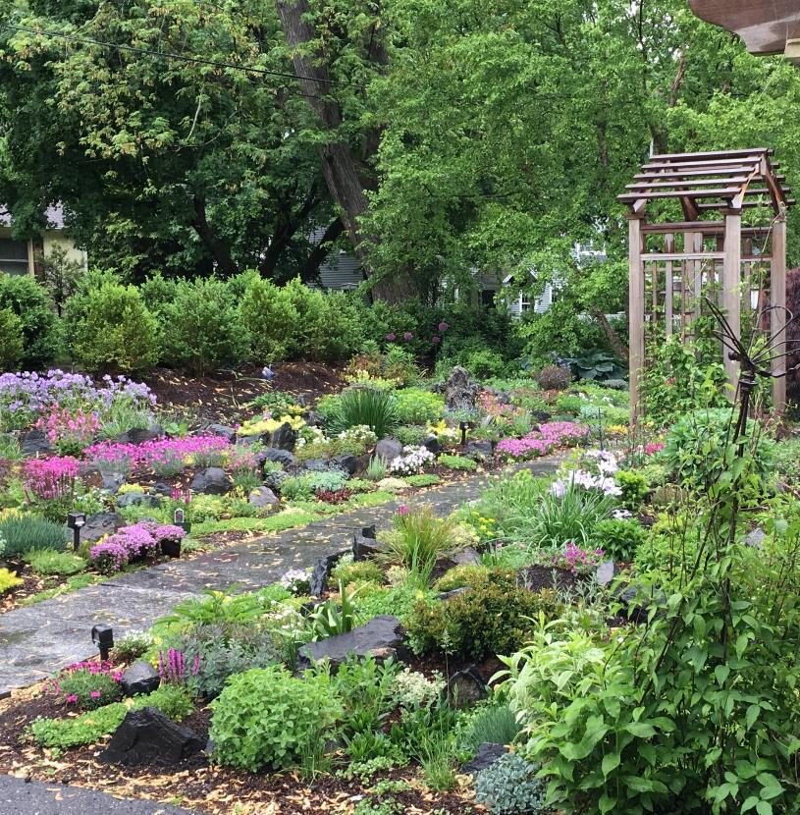

SUSTAINABLE BURLINGTON
LANDSCAPE HANDBOOK
THE TOOLS YOU NEED
To design a space, construct the project, and maintain your sustainable landscape.

Slide 2
Burlington is deeply committed to mitigating our contribution to climate change and being resilient to the impacts of climate change including drought, flooding, winter storms, and extreme heat. The way in which we manage our landscapes impact our water supply, water quality, biodiversity, energy consumption, and soil health. Sustainable landscaping is a win-win solution for our community and our natural resources because it: - Increases biodiversity - Reduces demand on our limited water supply - Improves water quality - Mitigates of flash flooding - Increases resiliency to drought - Reduces energy consumption and maintenance needs - Increases potential for carbon sequestration - Enhances ground water recharge and reduced runoff during storms This handbook is designed to help you create, install, and care for your landscape in a way that conserves water, takes the changing climate into account, and promotes the health of native species. We hope you find this handbook useful in inspiring and creating your own sustainable landscape. We thank you for doing your part to create a sustainable Burlington. This handbook was based on a product created by the Town of Concord in partnership with Kim Lundgren Associates, Inc. and Bohler Engineering and which was funded by a grant provided by the Metropolitan Area Planning Council and the Barr Foundation. Special thanks to Concord Sustainability for sharing this resource and to the other Town of Concord Departments for their contributions. Yours in sustainability, Town of Burlington Staff https://www.burlington.org/285/Residential
SUSTAINABLE BURLINGTON

Slide 3
Table of Contents
1
PHASE 1: PLANNING AND DESIGN
Getting Started: Who Will Do the Work?
Draw a Scaled Map of Your Property
Analyze Your Property: Observe and Interact
Assess Your Needs and Set Goals
Determine Space Layout
Create Your Design
Get to Know Your Style
PHASE 2: CONSTRUCTION AND INSTALLATION
Metrics of Success
Understand Local Bylaws and Regulations
Deal with Invasive Species
Limit Erosion
Mitigate Existing Drainage Issues
Choose Plants That Fit Site Conditions
Create a Planting Layout
Install Your Plants
Establish Your Landscape
PHASE 3: MAINTENANCE
Consider Community
Consider the Changing Climate
Water Regime
Certified Landscapes
Lawn Care
Controlling Invasive Species
Other Maintenance Methods
Planting For the Future
Additional Resources
----------
4
6
7
10
11
12
14
----------
15
16
18
19
20
21
22
23
27
----------
30
31
32
40
41
42
48
49
51
2
3

Slide 4
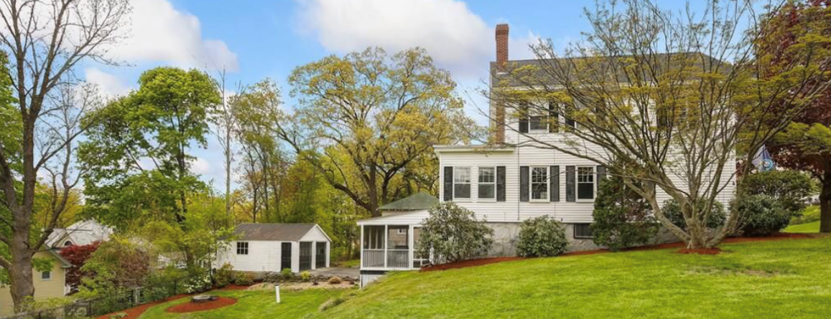

PHASE 1: Planning and Design
STEP 1
Getting Started. Who Will Do the Work?
Before you start your sustainable landscape project, ask yourself how much time you have and how involved you want to be in the process. Local professionals can help at any stage of your project and resources are available to help you complete your project on your own. Think about how to split up the work based on what you would like to tackle yourself and where you might want to work with a professional.
DESIGN
INSTALLATION
You can go through the design process and install the project yourself. This handbook provides steps for each phase in the process. Set achievable goals and start small.
OPTION 1
YOU
YOU
You can design the project and then have a contractor install. If the scope exceeds what you would like to get involved in, no worries! A contractor can work with you to bring your plan to life.
OPTION 2
YOU
CONTRACTOR
You can have a professional design your property’s landscape and then install what you can with the assistance of a contractor. Working hand in hand with a professional designer can be a great way to plan for your property and bring in creative ideas.
OPTION 3
PROFESSIONAL
YOU
(with assistance of a contractor)
You can hire a professional designer and a contractor to install. There are companies that will take care of the design and installation. This is called a design/build firm. This allows for an easier transition from each of the different phases from planning to construction, and in some cases, even maintenance.
OPTION 4
PROFESSIONAL
CONTRACTOR

Slide 5
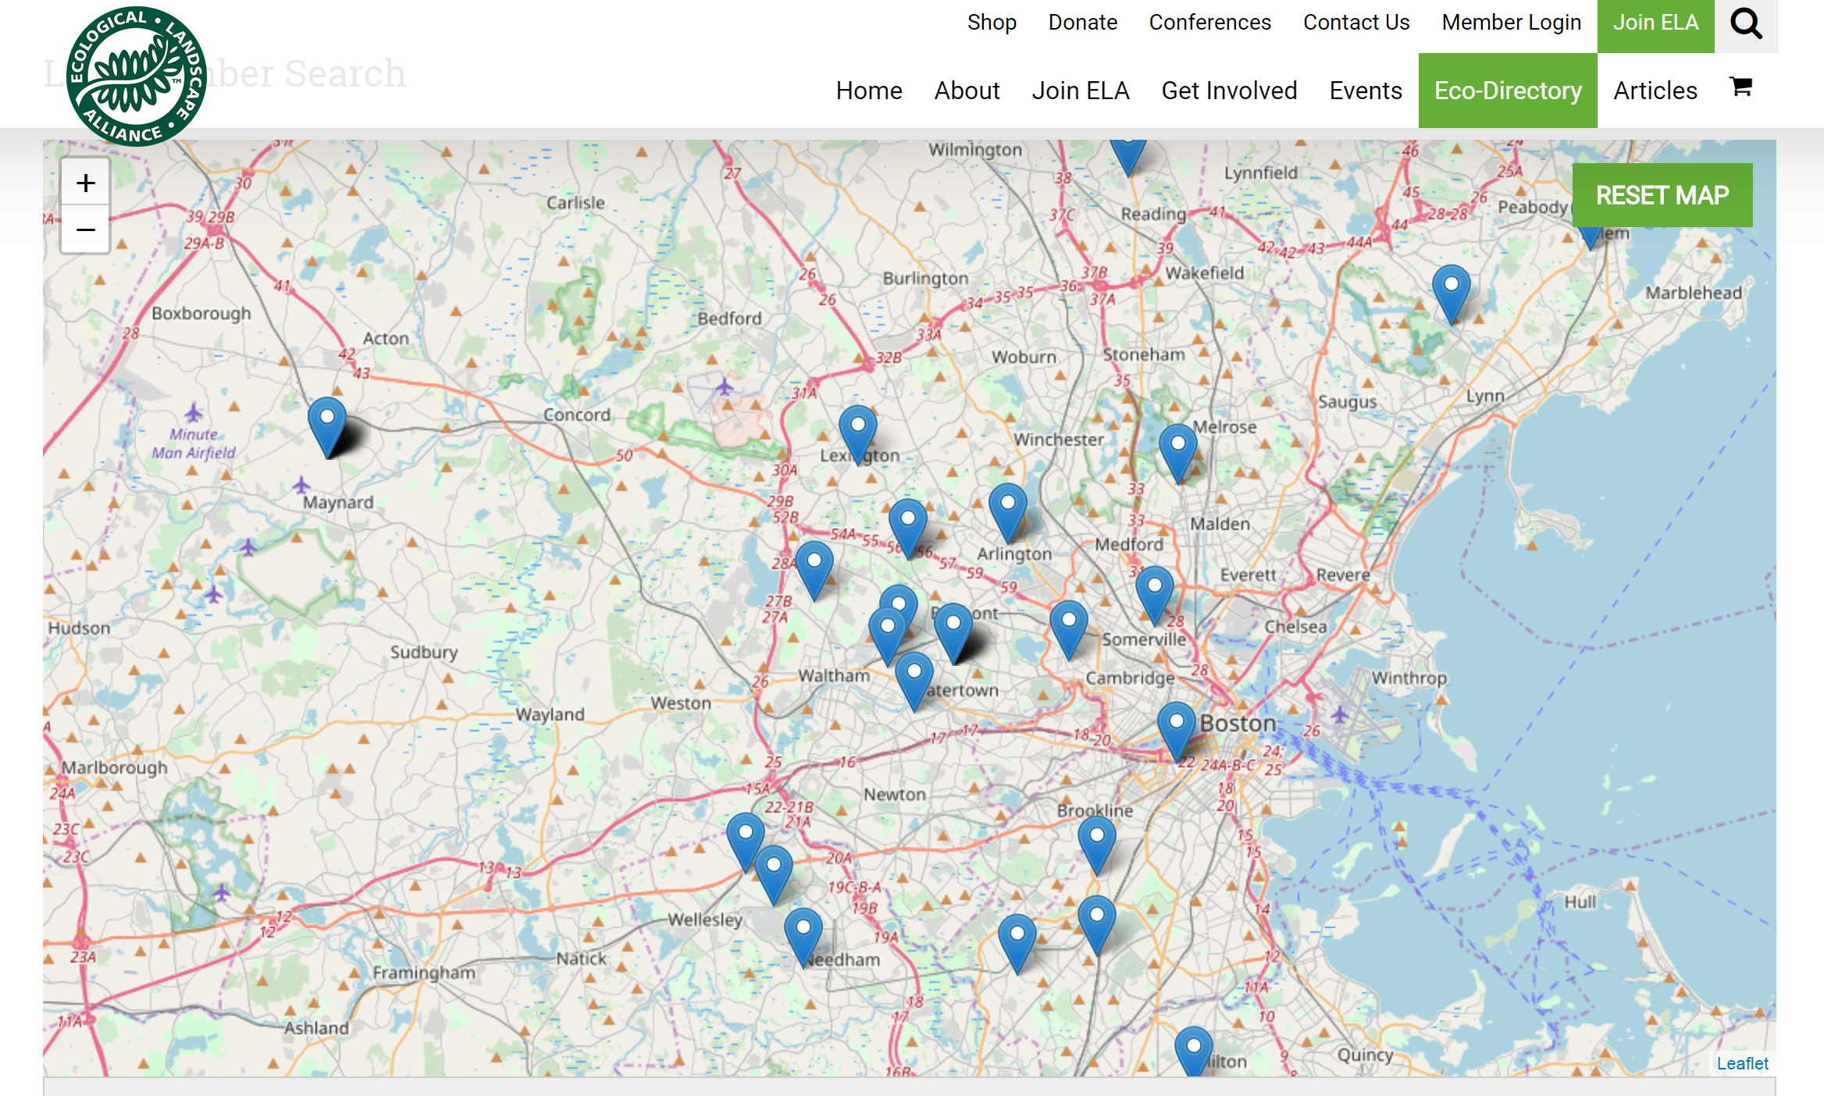
PHASE 1: Planning and Design
STEP 1
Getting Started. Who Will Do the Work?
FIND A PROFESSIONAL THAT CARES ABOUT SUSTAINABILITY
These resources can help you find a local professional with a focus on sustainable landscaping practices.
Tower Hill Botanic Garden is a hub that can connect you to local sustainable designers and builders.
Ecological Landscape Alliance (ELA) provides access to webinars, events, resources and connections to local professionals.
Massachusetts Horticulture Society has online resources and lists of local events.
American Society of Landscape Architects and Boston Society of Landscape Architects have databases to search for landscape designers in the area, as well as sustainability articles.
Grow Native Massachusetts provides a list of landscapers with a sustainability mission.
An example search result for sustainable practitioners around Burlington, through Ecological Landscape Alliance.

Slide 6
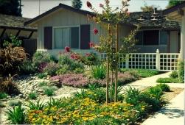

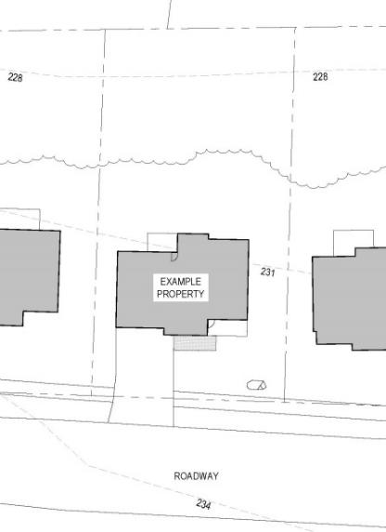


PHASE 1: Planning and Design
STEP 2
Draw a Scaled Map of Your Property
This is an important next step in the planning process. Having a scaled drawing of your property can help fuel a productive conversation with a contractor or get you started on the right foot in creating your own design.
WHAT TO INCLUDE:
Property lines - You want to ensure you’re working only on your property and not your neighbor’s! If you are unsure where your property lines are, you can reference Burlington’s Interactive GIS map to get an approximation or have a surveyor come out and identify them definitively.
Footprint of existing structures – Be sure to include structures such as porches, sheds, decks, or existing patios.
Existing trees, shrubs, plant beds – Indicate where the softscape elements are including existing beds, trees or shrubs that you have.
Location of utilities – Mark septic system, light poles, overhead wires, and underground lines. Call Dig Safe® ((888) DIG-SAFE) if you need help locating underground utilities.
Environmental constraints (wetlands, streams, ponds, floodplain, vernal pools) – Know where these are on your property to understand if you need a permit from the Natural Resources Commission to construct your landscaping project. Burlington’s Interactive GIS system is a good place to start.
Scale reference – Always draw your plan to scale (i.e. 1-inch equals 10-feet). If you are off, it can cause challenges when it comes to installation. Show a scale bar so that you and others know what scale you are working at and can quickly measure from it.
North arrow – This will help you determine the sunny and shady areas on your property.
MAPPING RESOURCES
Mass Mapper provides data such as FEMA flood mapping, topography, areas of critical environmental concern, and conservation areas.
Burlington’s Interactive GIS is a localized mapping resource with town-specific information.
SUGGESTED SCALES
Small lot: 1 inch = 10 foot
Large lot: 1 inch = 20 foot
PRO TIP
Use graph paper and let one box equal a certain number of feet.

Slide 7
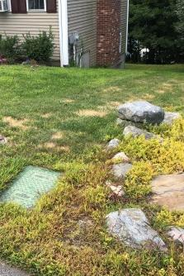
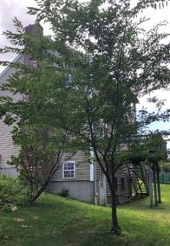
PHASE 1: Planning and Design
STEP 3
Analyze Your Property: Observe and Interact.
This step is often rushed or overlooked, but it is one of the most important aspects of planning your landscape. Take the time to analyze your property’s characteristics and identify areas of concern and opportunity on your property. Areas of concern can be transformed into an opportunity for creative landscaping. Begin thinking about the potential your site offers, your landscape style, and the sustainable elements that you would like to incorporate.
ENVIRONMENTAL CONSIDERATIONS
WETLAND RESOURCE AREAS – State and local laws may apply to your landscaping project. Check with the Conservation Department before you begin.
INVASIVE PLANTS – Identify invasive plants on your site. The Town of Concord has a nice online guide that provides images along with helpful information. There are also several mobile apps, such as iNaturalist, Seek, and PlantNet that allow you to take a photo of a leaf and identify the plant.
EXISTING HABITATS – What types of habitat exist on your site? Burlington’s BioMap can help you determine if your property falls in a critical habitat and tips on how to preserve biodiversity.
SOILS – You can have your soil tested to understand what nutrients may be high or low in your soils.
WATER – What kind of plants will do well on your property? Understand the moisture regime of your soil so you can plant the right plants in the right spot.
LIGHT – This is another important consideration. Plant shade-tolerant plants in shady areas, and sun-loving plants in more open areas. The Native Plant Trust includes light and soil moisture considerations for all native plants.
STEEP SLOPES OR EROSION – Notice areas with significant slopes. Is this leading to erosion? Why?
ADDITIONAL CONSIDERATIONS
Do you have kids or pets that use the space?
Do you have a patio or other paved areas?
Are there views you’d like to maintain?
Where does the natural or artificial light come from?
Do you want your space to feel private or public?
Are there areas you want to screen?
Where do you regularly walk?
Where do animals travel?
Where are the entrances/exits of the space?
Where do you get deliveries?

Slide 8
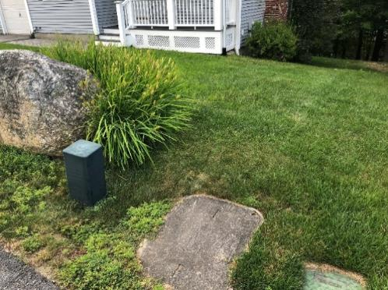
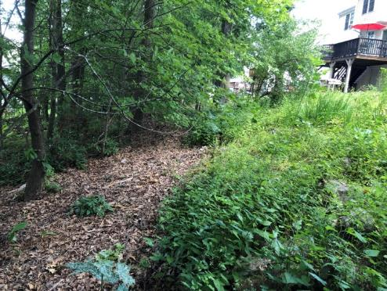
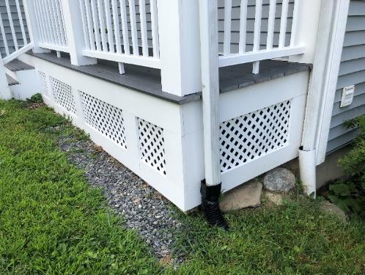
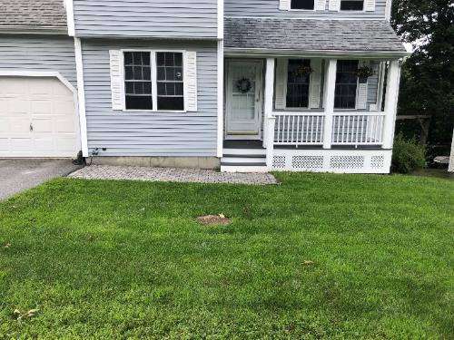
PHASE 1: Planning and Design
STEP 3
Analyze Your Property. Observe and Interact.
Consider the following features when walking your property, examining existing constraints and opportunities. Look for space that is underutilized and brainstorm alternative uses. Observing your neighbors’ landscaping can be a great place for inspiration. Don’t be afraid to think outside the box.
Underground Utilities and Utility boxes
Opportunity: Shallow plantings to screen
Steep Slopes and Shade
Opportunity: Beautiful shade planting spot. Let the slope plantings go wild with only native plants. Remove any invasive plants.
Roof Gutters Downspout
Opportunity: Collect rainwater in a rain barrel or redirect into a rain garden
Full Sun and Slope Towards House
Opportunity: Collect water from slope. Sunny perennial pollinator plants

Slide 9
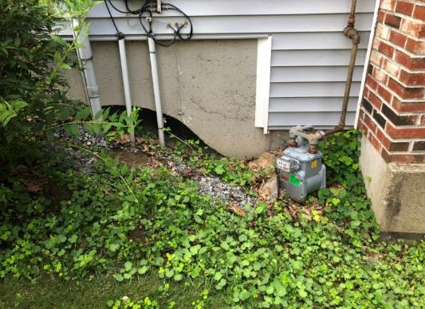
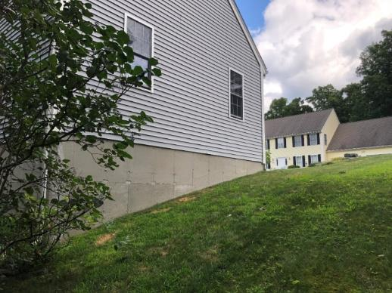
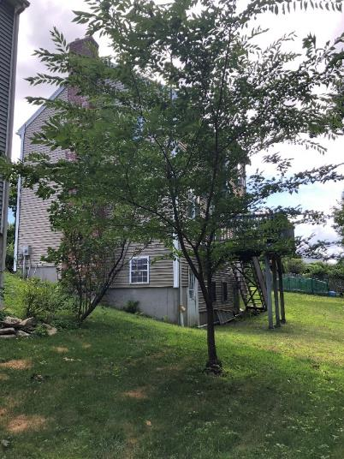
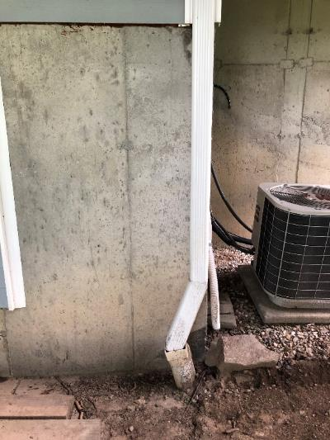
PHASE 1: Planning and Design
STEP 3
Analyze Your Property. Observe and Interact.
Exposed Utility Lines and Erosion Issues
Opportunity: Screen utilities with native plants. Direct water into rain garden at the base of the slope
Steep Slopes and Exposed Foundation
Opportunity: Native plantings to screen foundation
Poor Tree Selection
Opportunity: Remove and plant a native plant bed.
Downspout and AC unit
Opportunity: Collect water in rain barrel. Add foundation plantings.

Slide 10
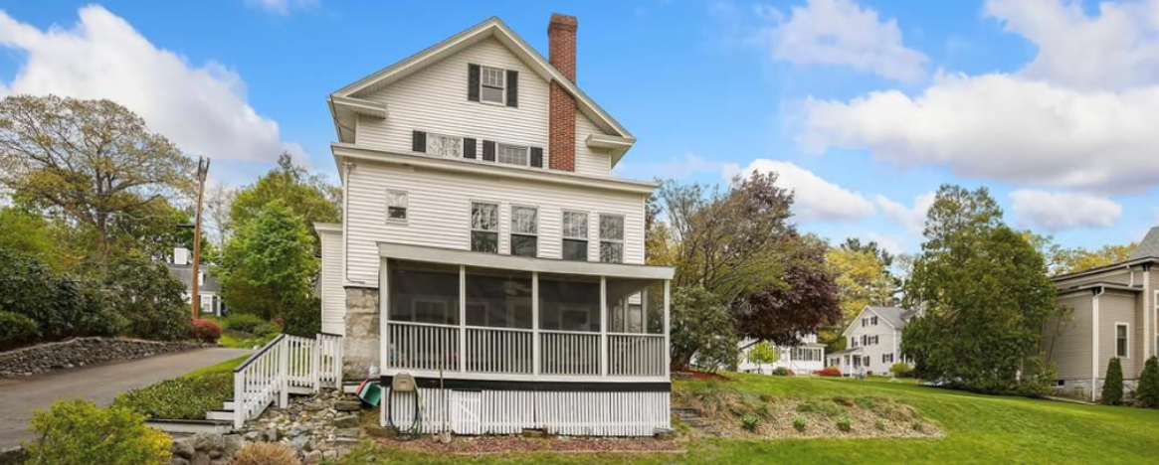
PHASE 1: Planning and Design
STEP 4
Assess Your Needs and Set Goals
The final step of analyzing your property is to set sustainability goals and assess the needs you have in order to meet those goals. Start with small steps. If you have a goal (example: I want to create a raingarden in my backyard), break it down into steps of how you want to achieve that goal and assess if you will need help attaining that goal. Here are some ideas of sustainable landscaping goals you might consider.
REDUCE WATER USE – Is there a way to capture rainwater on your site and use it for your benefit? Think about converting lawn areas to planting beds that would require little to no water once the plants are established. If you have lawn areas, consider amending the soil with organic matter. You will be surprised how little water a lawn needs if the soil is healthy. See Phase 3 on maintenance for more information on how to reduce your water use.
CAPTURE RAINWATER – Think beyond the rain barrel. There are rain devices, like tanks, that fit between your deck joists, or bags that can hide in crawl spaces. Small pumps allow you to water your garden with this type of rain storage.
IMPROVE SOIL WITH ORGANIC MATERIAL – Consider mulching your leaves or adding compost. This is free food for your plants as the leaves begin to decompose. This is a great fall project.
REDUCE OR REMOVE IMPERVIOUS SURFACES – Burlington is facing onerous federal requirements to reduce the amount of polluted stormwater runoff it discharges to waterways. Reducing the amount of impervious cover—asphalt, concrete, etc.—on your property today will help to reduce the amount of pollutants discharged to the stormwater system and could minimize the impact of a stormwater utility, should such a fee be adopted in Burlington.
INCREASE POLLINATOR PLANTS - It’s a fact that bee populations are declining. Why not help them out in your own backyard? You will begin to notice that native pollinator plants not only help the bees but a wide range of animals!

Slide 11
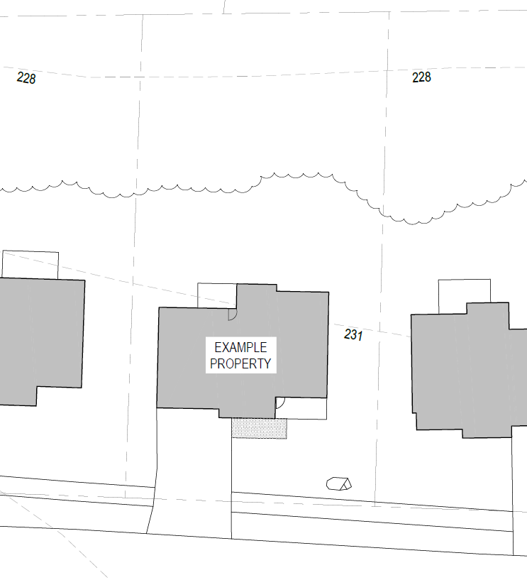

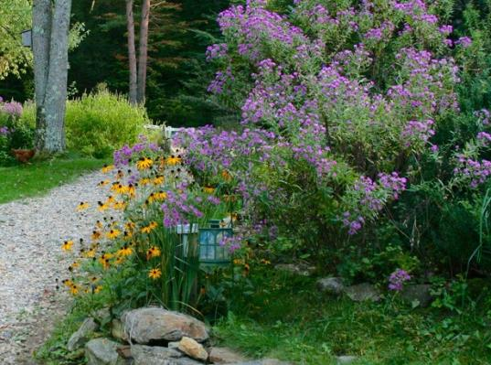
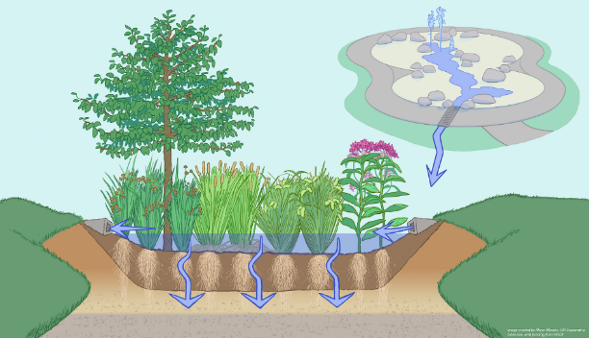
PHASE 1: Planning and Design
STEP 5
Determine Space Layout
Keeping your goals and needs in mind, start designating areas of your land for specific landscaping elements.
PRO TIP
Make a rough bubble diagram to determine your space layout. A bubble diagram is a quick way to circle areas where potential upgrades could happen on your property. See the following page for what each bubble might represent.
PRO TIP
As you are planning where your plants will go, take seasonal winds into account and experiment with ways to maximize pleasant aromas in frequently visited spaces of your landscape. Imagine stepping out your door every spring morning, down wind from a blooming tree or bush!
PRO TIP
Consider how you can use dense plantings to block wind or create a visual screen to increase privacy on your property.

Slide 12
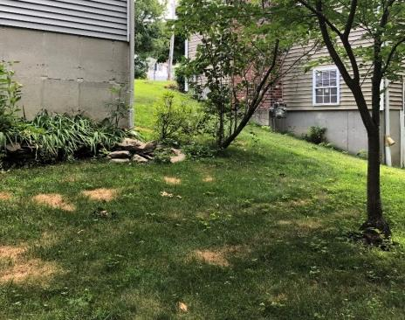
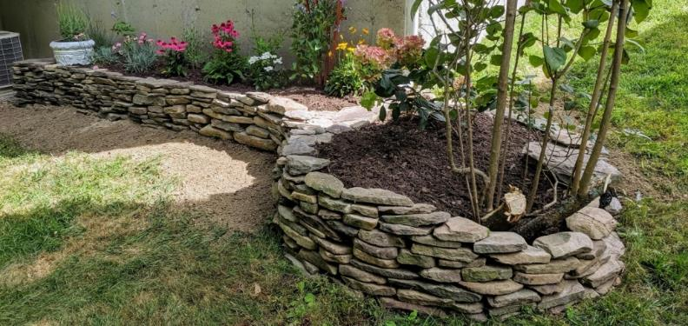
PHASE 1: Planning and Design
STEP 6
Create Your Design
Once you have made general land use designations, brainstorm alternative layouts. Consider what areas people travel through and how the space will be used. Try different combinations in relation to rooms of the house, surrounding areas, and potential views.
OPTION 1
OPTION 2
Option 1
Option 2
6
6
5
5
3
2
1
3
1
1
2
4
1
4
1
6
EXAMPLE COMPONENTS
TO CONSIDER
Pollinator Plantings
Rain Garden
Rainwater Capture
Pervious Paving
Outdoor Patio
Lawn Alternatives and Reduction
Combine the best elements of your layouts to create your final design. Capitalize on how things work together and be mindful of plants that do not tolerate each other.
PRO TIP
Not all plants work for every space. Research your plants to make sure they meet the requirements of your space.
BEFORE
AFTER

Slide 13
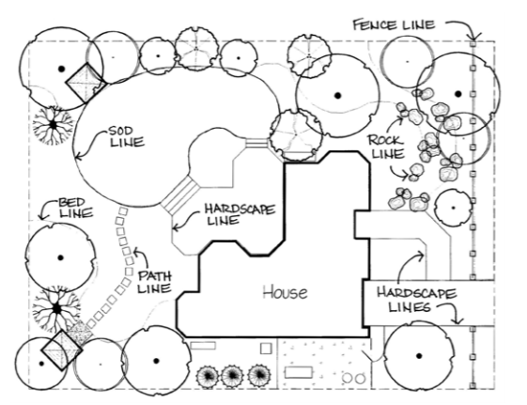
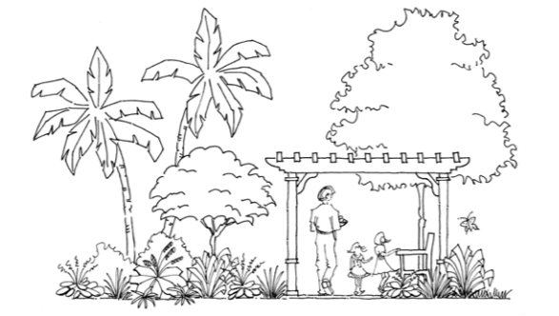
PHASE 1: Planning and Design
STEP 6
Create Your Design
There are no hard and fast rules, but these guidelines, modified from the University of Florida’s Basic Principals of Landscape Design, will help you create an aesthetically pleasing and sustainable landscape:
LINES IN LANDSCAPE DESIGN.
PROPORTION IN LANDSCAPE DESIGN.
LINE: Line in the landscape is created by the edge of two materials. Lines control the movement of the eye and are therefore a powerful tool for a designer. Use different types of line to create a visually varied landscape:
Straight: Structural, forceful, and lead the eye to a focal point
Curved: Informal, natural, relaxed, move the eye more slowly, and add mystery by creating hidden views
Vertical: Move the eye up, making the space feel larger
Horizontal: Move the eye along the ground plane
Mimicry: Complement the lines of your house and other structures with plantings
SIMPLICITY: The best designs are rarely the most complex. Keep it simple.
PROPORTION: When plants, structures, and people are in proportion, it creates a balanced and harmonious composition. Also consider proportion of open space—people tend to feel more secure in smaller open areas, such as patios and terraces.
REPETITION: Use repetition with care—too much can create monotony, while too little can create confusion. Consider alternation or patterns to make simple repetition more interesting. Groups of three or other odd numbers are often most visually appealing.
UNITY: Unity refers to the perceived sense that everything is connected and works together to create the whole. Employing a design theme or style will help you achieve unity in your yard. Consider how to make your colors, plants, and layout create a unified style.
PRO TIP
Designers see space as “outdoor rooms.” Think of creative ways to make your space feel more comfortable.
Other properties to consider include, color, texture, and form. The University of Florida’s Basic Principals of Landscape Design has more information on design principals.

Slide 14
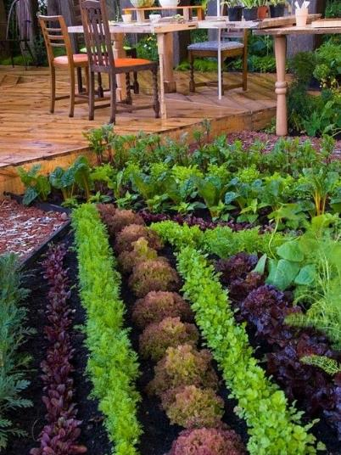
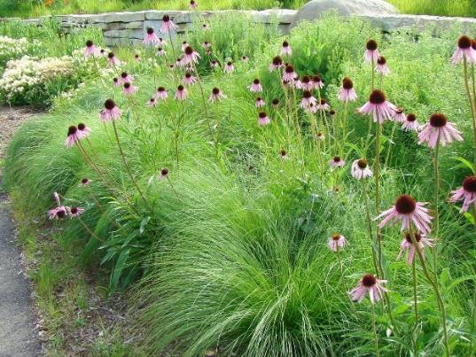
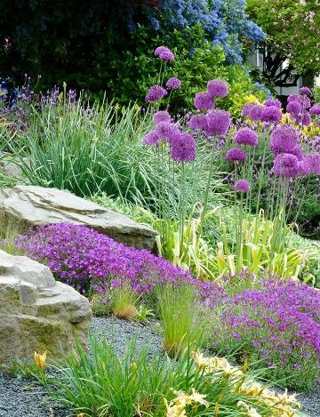
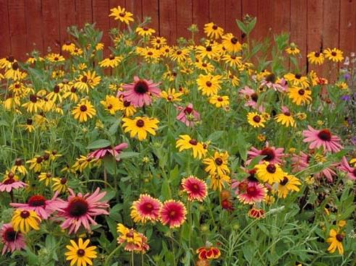
Get to Know Your Style
THIS IS THE FUN PART!
Mix of grasses and perennials
Edible landscapes
New England wildflower garden
Rock Garden

Slide 15
PHASE 2: Construction and Installation
Metrics of Success
Sustainable Landscape Construction
by Kim Sorvig and J. William Thompson
This book provides a thorough reference on how to build landscapes that work with—rather than against—nature. The book highlights 10 core principals:
Keep healthy sites healthy
Heal injured sites
Favor living, flexible materials
Respect the waters of life
Pave less
Consider origin and fate of materials
Know the costs of energy over time
Celebrate light; respect darkness
Quietly defend silence
Maintain to sustain
Provides a focal point or view
Includes low maintenance materials
Includes lawns and plants that do not require irrigation
Creates “outdoor rooms” for larger yards (see page 13)
Provides space that feels like an extension of the house
Offers smooth transitions from one space to the next
Provides year-round interest
Maximizes native plantings
Provides wildlife habitat
Incorporates on-site stormwater management
Mitigates erosion

Slide 16

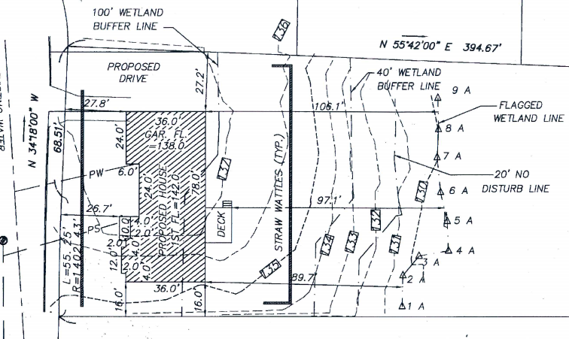
PHASE 2: Construction and Installation
STEP 1
Understand Local Bylaws and Regulations
It's crucial for the Town and the State to protect the natural environment. Each community has their own restrictions, buffer zones, and protected habitats. For more information about local environmental bylaws and sustainable landscaping, visit the Garden Continuum.
REVIEW STATE AND LOCAL BYLAWS AND REGULATIONS
Check out the Town’s Bylaws to determine whether your plans are permitted and identify restrictions. Specific bylaws to review include:
MA Wetlands Protection Act
Burlington Wetlands Bylaw
Burlington Wetlands Regulations
Burlington Conservation Commission Policies
Burlington Stormwater Bylaw
FIND OUT WHERE UNDERGROUND
UTILITIES ARE LOCATED
Call DIGSAFE (811) before you dig. It’s the law!
ARE YOU IN A WETLAND AREA?
If your project falls within 100 feet of wetland resource areas, including Certified Vernal Pools, or 200 feet of perennial streams or of streams identified in the Burlington Wetlands Regulations, review from the Natural Resources Commission may be required. Please contact the Conservation Department before you begin!
An example of wetland buffers shown on a site plan.
CHECK TO SEE IF YOUR PROPERTY OVERLAPS WITH ANY OF THESE ZONES:
Wetland buffer
Riverfront buffer
Vernal pool buffer
Perennial stream buffer
No build zones
FEMA flood zones
If so, contact the Burlington Conservation Department for guidance on permit requirements.

Slide 17
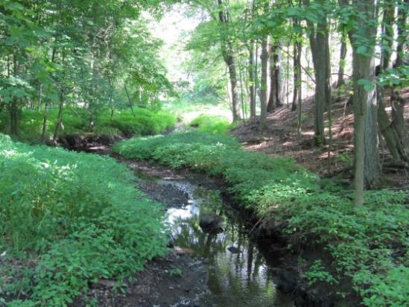
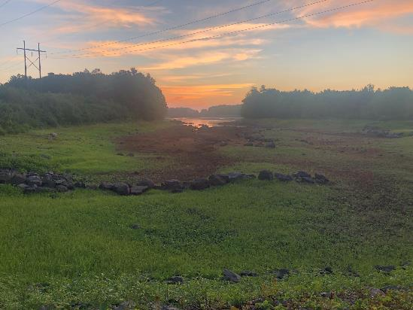
PHASE 2: Construction and Installation
STEP 1
Understand Local Bylaws and Regulations
WETLAND & STORMWATER BYLAWS
If your plans involve construction or substantial changes to grading, check to see if you are close to resource areas protected by the Burlington Conservation Department/Commission or hit the threshold for a Stormwater Permit. See Phase 3 of this handbook for additional information on Burlington’s water supply and water-saving tips.
Wetlands Permit
A wetlands permit from Conservation is required for all work, other than routine maintenance, proposed to occur within floodplain, 100 feet of a wetland*, or 200 feet of a stream (as defined by the Wetlands Protection Act Massachusetts General Laws (MGL) Chapter 131, s40 or the Burlington Wetlands Bylaw Article XIV.)
Stormwater Permit
A stormwater permit is required for any land disturbance equal to or greater than 5,000 square feet of land or adding additional impervious surface totaling 5% or more of the lot, regardless of whether the activity is proposed in or near wetlands or not.
R
RESOURCES:
Get a list of wetland scientists from Conservation staff.
Get tips and videos on the Burlington Sustainable Landscaping webpage

Slide 18
PHASE 2: Construction and Installation
STEP 2
Deal with Invasive Species
Invasive species should be removed before you start planting any new plants. Plant natives as soon as invasives are removed to help prevent regrowth of invasive species. Invasives will need to be monitored and removed for a few seasons as there will still be seed and roots in the soil that can resprout. Even if it takes a full growing season to completely remove invasive species, it will ultimately save you time because ongoing invasive species management will be a very time-consuming task. Invasive species are covered in more detail in Phase 3.
MANAGING INVASIVE SPECIES ORGANICALLY
Herbicides should only be used as a last resort as they can run off during a storm, contaminating our waterways. Here are some alternative methods:
Full Root Removal – Fully removing the plant with all of its roots is critical to prevent the plant from sprouting again.
Consistent Cutting – Trimming, mowing, and weed-whacking puts a strain on plants and can deter them from growing back in full force. This needs to be done at least 8 to 10 times during the growing season to be effective at weakening invasive plants.
Solarization – Let the sun do the work to overheat the ground and prevent noxious weeds from germinating
Seed Bank Control – carefully removing all parts of the invasive plant, including seeds, stops the spreading of the plant.
Resource: Massachusetts Invasive Plant Advisory Group provides a list of the 35 invasive species in Massachusetts with additional links and resources..
MANAGING INVASIVE SPECIES WITH TARGETED HERBICIDE
Some invasive species, such as Oriental Bittersweet and Knotweed, or large infestations of other invasives can be especially difficult to eliminate organically. If this is the case, limit the amount of herbicide needed by cutting the stems and dabbing what is left with herbicide. Avoid spraying plants to limit damage to surrounding plants and wildlife. If you need assistance, you can hire a licensed herbicide applicator.
If you are removing invasives within wetland resource areas or buffer zones, contact the Burlington Conservation Department before you begin.

Slide 19
PHASE 2: Construction and Installation
STEP 3
Limit Erosion
BEFORE YOU START PLANTING
It is important to stabilize any slopes on the property. You should consider stabilizing slopes with erosion control barriers (described below) when:
The slope is greater than 3:1
When water is being directed down the slope
When soil conditions are not favorable and can easily wash away
Removing invasive species on a steep slope.
SUSTAINABLE EROSION CONTROL METHODS
Secure coir logs across the slope with stakes and plant uphill of the logs
Jute netting
Natural mesh with photodegradable netting
Seed free straw with an organic tackifier to prevent fly-aways
Soil stabilizing plants
Deep rooted plants provide the best long-term erosion control!
Securing netting over the slope and planting native grasses.
The slope reinforced by native plantings.

Slide 20
PHASE 2: Construction and Installation
STEP 4
Mitigate Existing Drainage Issues
Notice areas where water is naturally draining near your house. You will want to direct water away from your house to avoid flooding issues. When addressing drainage issues keep the following tips in mind:
SLOW: all draining water should be moving slowly; avoid gushing water even during a storm.
SPREAD: evenly distribute drainage across the property.
SINK: direct water to the best area for it to infiltrate.
DRAIN WHEN NECESSARY: even in a wetland, not all the water can infiltrate. You will need to identify places where the water can ultimately exit and drain.
Remember S.S.S.D
BEFORE
DURING
AFTER
Example of water naturally channeling on a site. Soil stabilization techniques were used and plantings were put in place.

Slide 21
PHASE 2: Construction and Installation
STEP 5
Choose Plants That Fit Site Conditions
Understanding your property’s Native Plant Community will help establish what plants will thrive. Take cues from what plants are already there. As you choose plants to fit into your design, consider the following questions:
ARE YOU HOPING FOR A MORE TRADITIONAL OR NATURAL DESIGN SPACING?
TRADITIONAL: You can see the ground, tends to feel more formal
NATURAL: Wild groundcover gives a more natural feel
SHOULD YOU USE CONSERVATION GRADE OR BALLED AND BURLAPPED TREES?
Conservation grade trees are typically smaller and bought in 1-3 gallon pots. While smaller, these generally establish faster and catch up to more full-grown tree in 3-4 years. They only require regular watering for the first year. Native Plant Trust in Framingham and Parterre Ecological can help you find conservation grade trees.
Balled and burlapped trees are larger upon purchase but need more care to establish (daily watering for 2 years). These trees that have been cared for by a nursery for a couple years and are also going to be more expensive.
WHAT IS YOUR WATERING CAPACITY?
Consider how you will be watering your new plants and how much time you have to water them. Only choose plants that require a lot of watering to get established if you have the capacity to do so.

Slide 22
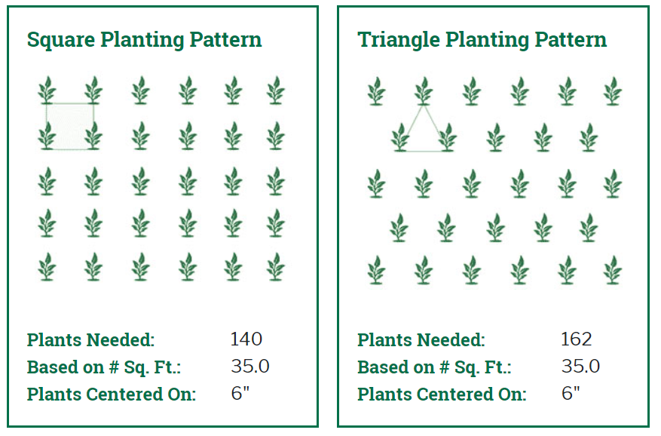
PHASE 2: Construction and Installation
STEP 6
Create a Planting Layout
PLANT LAYOUT
Situating the plants on the site where they will eventually be planted is a great way to help determine the correct spacing that is needed before full installation.
Start with the large, structural plants (trees and shrubs). Choose location based on relation to existing structures (i.e., how far do you want the full-grown tree from the house or walkway?).
Once your trees and shrubs are planted, lay out smaller plants, such as perennials.
Finally, plant the groundcover. Ferns or no-mow grasses are low-maintenance groundcover choices to consider.
This plant calculator can help you determine the number of plants needed for an area.

Slide 23
PHASE 2: Construction and Installation
STEP 7
Install Your Plants
PLANT INSTALLATION (TREES, SHRUBS)
Native plants planted in the right conditions require little to no amendments. Don’t use compost – it is too nutrient-dense for native species.
Find root flares on trees. The root flare is the area at the base of the tree where the trunk transitions to roots. Scrape off clay and excess soil to reveal the roots before planting.
Tree holes should be twice the width of the root ball.
Use water to eliminate air pockets. After placing the tree, put in about half the soil and water the hole. Then, fill the rest of the hole with soil and water again.
PLANTS COME IN ALL SHAPES, SIZES AND VARIETIES
Use this guide to learn more about how to plant your new plants.
An example of a root bound root ball. TIP: use a knife to cut the roots and encourage growth
PRO TIP
After digging the hole, sprinkle in organic root starter to help promote healthy, strong roots
PRO TIP
Water all newly established plantings in the first year in order to help them establish new roots

Slide 24
PHASE 2: Construction and Installation
STEP 7
Install Your Plants
PLANT INSTALLATION (NO MOW SEED)
Plant in late spring or early fall
Grade soil surface to reduce puddling or erosion
Divide area into an even number of plots and divide seed accordingly to split up the work
Toss the seed evenly by hand, making sure not to run out. Start with a light spread and add more until it’s gone.
Lightly rake into soil
Increase seed to soil contact by rolling with a grass seed roller or packing down with the back side of a shovel
WHAT SEEDS SHOULD I BUY?
Prairie Nursery, Prairie Moon Nursery, and Allen Seed’s websites all provide recommendations on what type of seed to buy.
PRO TIP
Applying too much seed can lead to over-competition and result in a dead spot.

Slide 25
PHASE 2: Construction and Installation
STEP 7
Install Your Plants
LIVE STAKES
Cuttings from dormant trees/shrubs can develop into new plants. The dormant season runs from late November to April.
Use a cutting 2-3 feet in length and bury 2/3 below ground.
The tree or shrub will mature in 3-5 years.
Learn more about live stake planting through the Natural Resources Conservation Service.
PRO TIP
Put up a fence around new live stake plantings because deer love to chew them.

Slide 26
PHASE 2: Construction and Installation
STEP 7
Install Your Plants: Meadows
If you have a sunny, open area in your yard, consider planting flowering plants and tall grasses and converting the space to a meadow.
MEADOW INSTALLATION
Seeding period: Late October to December and April to mid-June
Eliminate existing vegetation and seed bank before planting meadow. This may take time but will save you time and maintenance in the long run.
Carefully choose seed mix based on site conditions and desired outcome.
Divide seed and area into groups to break up planting
Rake seed lightly into soil
Mow 3-5 times in first season to prevent weeds from setting seed
Expect to see some color in year two, and for it to really take off in year three
Never fertilize a native meadow!
BEFORE
AFTER

Slide 27
PHASE 2: Construction and Installation
STEP 8
Establish Your Landscape
ESTABLISHMENT
After Installation, water once per day for the first two weeks (counting rain)
Week 2-4: water 2-3 times per week unless there is a significant drought
Water trees and shrubs during any dry periods for the first two years
WEEDING AND MANAGEMENT
A light layer (2 inches) of leaf mulch (cut up dried leaves) will help decrease weeds. Use your mower to shred dry leaves in the Fall and re-use onsite!
Remove weeds by roots during the first two years.
After two years, cut weeds at stem and let native species help manage weeds.
Use rabbit repellent and deer fencing until the plants are established.
PROTIP
You can use Irish Spring soap to repel unwanted animals. There are also plenty of other easy ways to prevent deer damage.

Slide 28
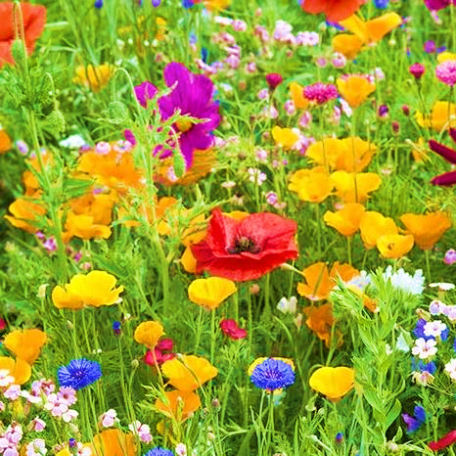
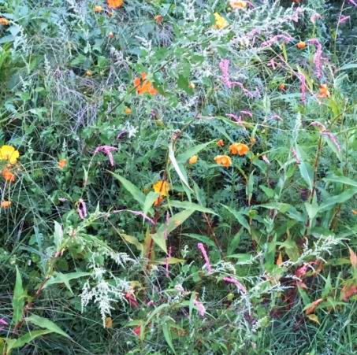
Key to Success…
PATIENCE
EXPECTATIONS FOR FIRST YEAR OF PLANTING…
…REALITY DURING FIRST YEAR OF GROWTH

Slide 29
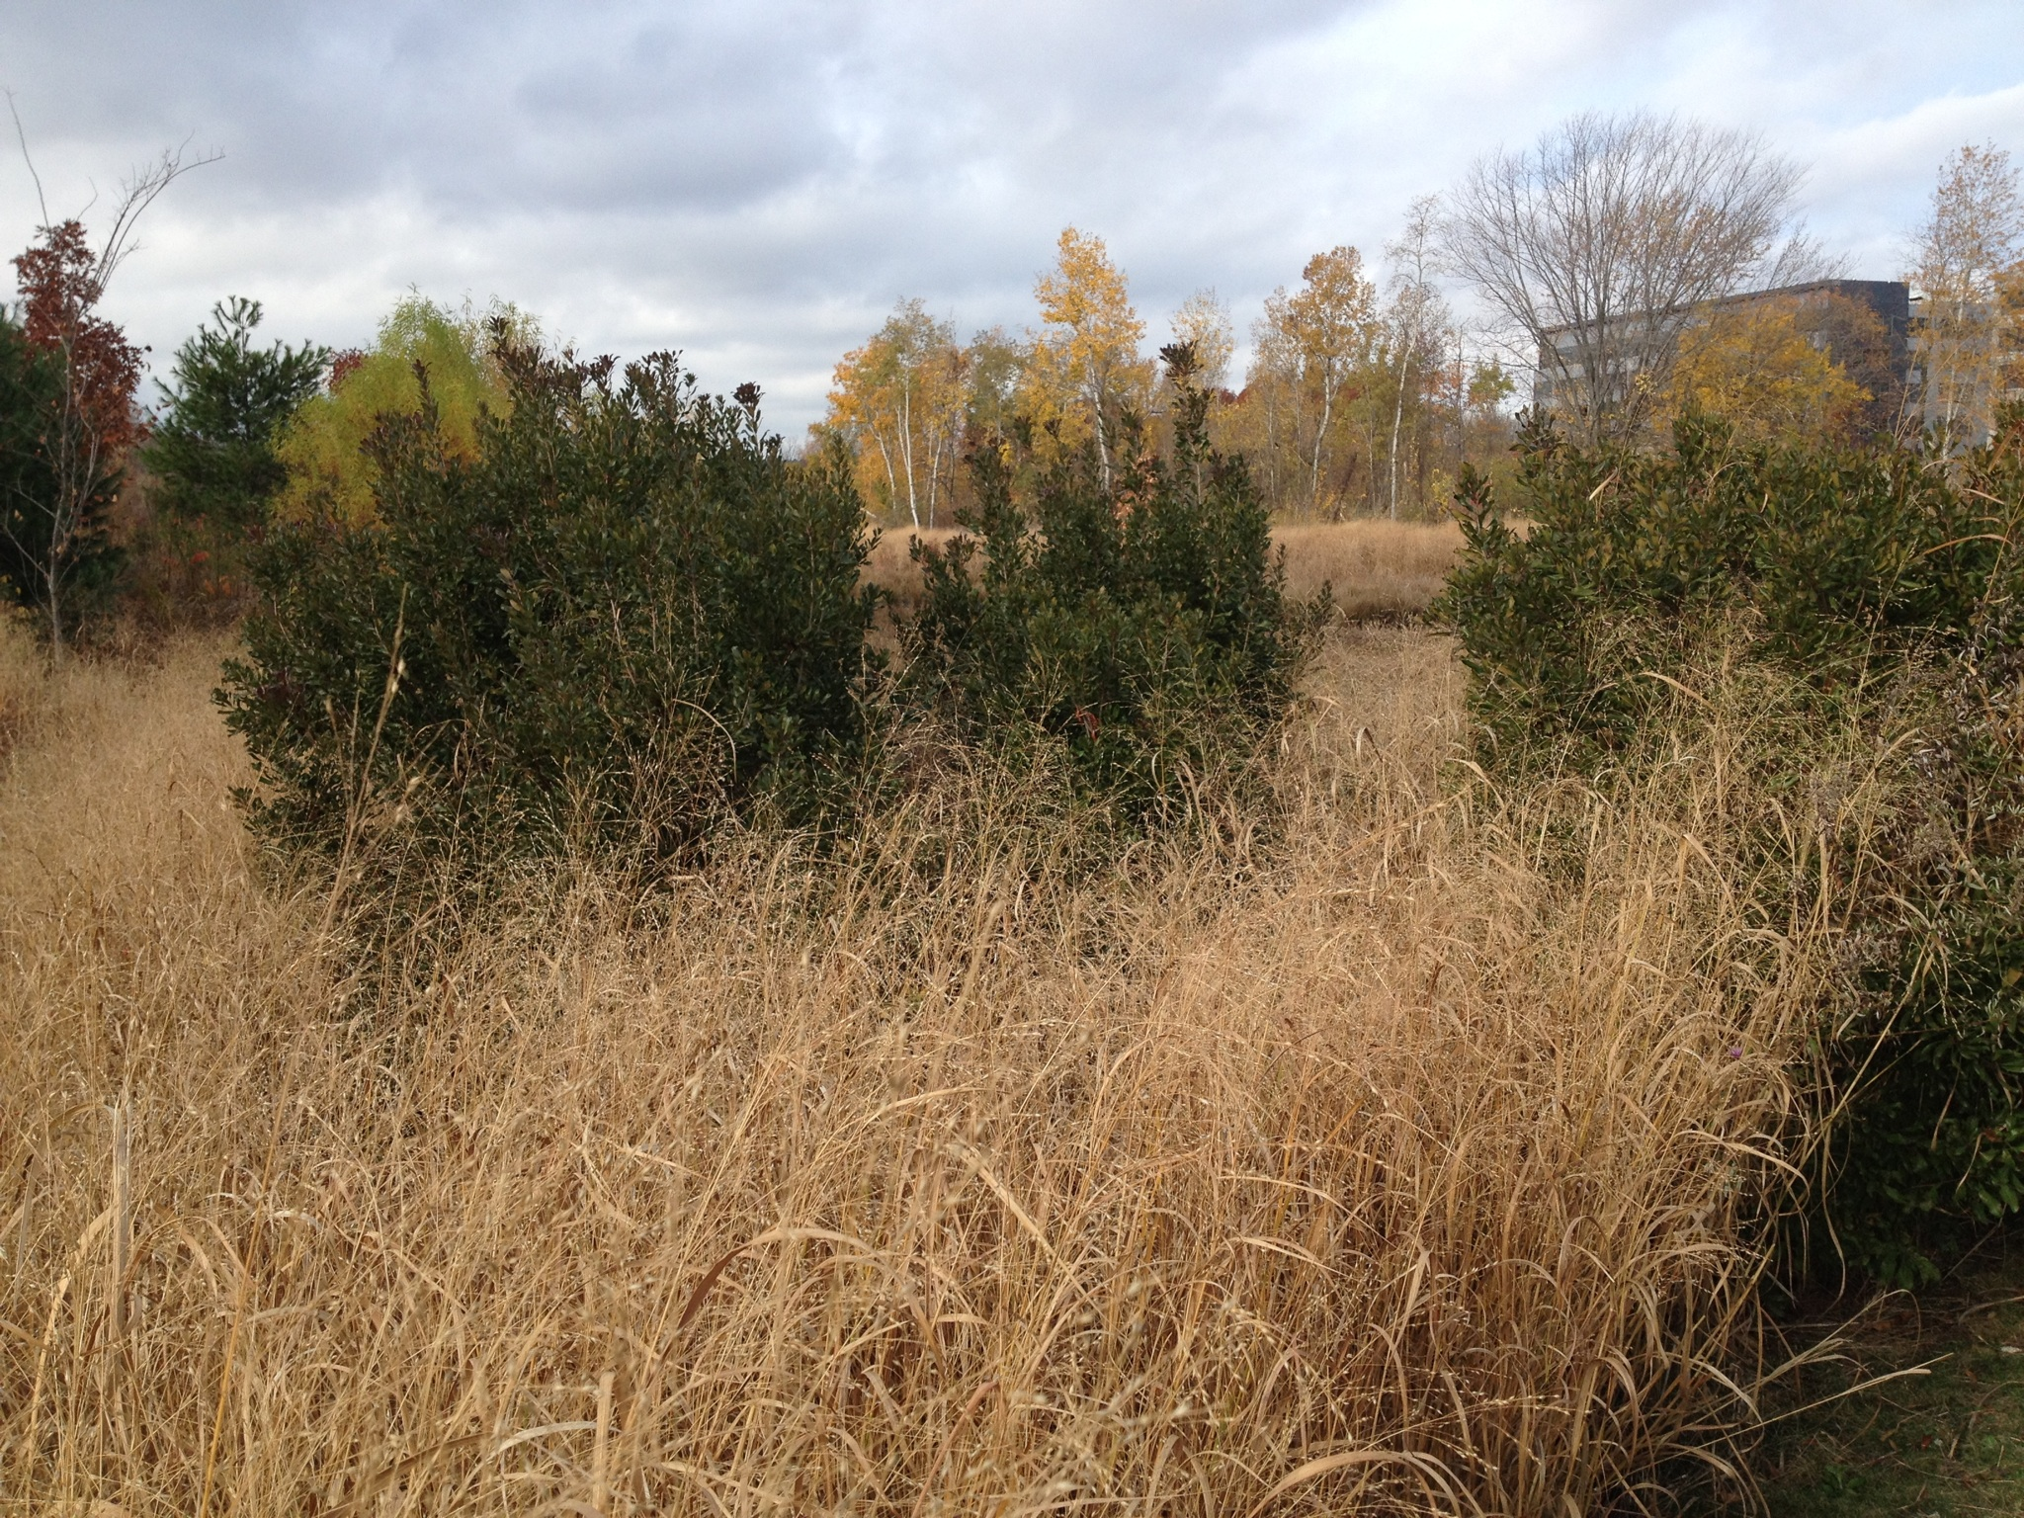
PHASE 3: Maintenance
Landscapes are always changing. Therefore, it is important to keep up with the needs and demands of your yard. There are a number of variables that affect the survivability of plants, lawns, and even structures on a seasonal basis. For example, varying precipitation, changing temperatures, and extreme weather events will all change the needs of a landscape. Even a natural or wild-looking landscape requires careful maintenance. Phase 3 will help you care for your landscape in a way that conserves water, takes the changing climate into account, and promotes the health of native species.
A 3.5-acre wetland in Cambridge that is regularly maintained in order to mitigate flooding. Photo Credit: Miles Connors

Slide 30
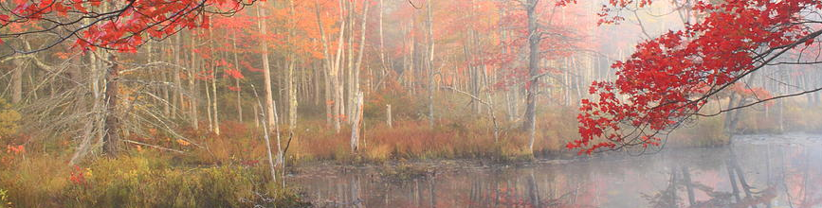
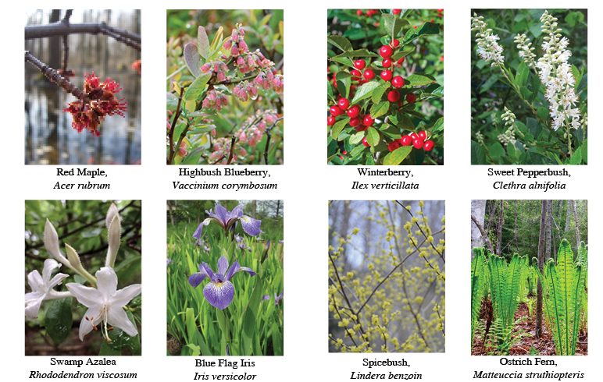
PHASE 3: Maintenance
Consider Community
As you contemplate your maintenance plan, make sure to consider the natural resources and habitats of your neighborhood and property. For example, if your property is adjacent to a red maple wetland, activities in upland areas immediately adjacent may adversely affect the functions and values of those wetlands, including clearing natural vegetation. Alternatively, if you live in an area that is plagued by invasive species, you will want to consider what native plants can effectively replace those.
HERE ARE SOME PLANTS YOU ARE LIKELY TO FIND IN THE
NATURAL LANDSCAPE

Slide 31
PHASE 3: Maintenance
Consider the Changing Climate
2023 was the hottest July on record, and the number of days over 90° F are projected to increase. We are also expected to get more rain, but less often – the rain that does fall will be in more intense precipitation. With the transition to the MWRA supply, Burlington’s water supply is stable, but the Town is subject to the State’s Drought Status. This is likely to lead to some continued restrictions, especially in the summer when lawn watering greatly increases peak demand.
Did you know?
Burlington was formerly served by a field of groundwater wells (Vine Brook Well Field) and one surface water reservoir (Mill Pond), which is filled by the Shawsheen River. Wells are susceptible to groundwater level drops caused by local droughts, and this well field was affected by a contaminate plume and the wells gradually brought offline. The Reservoir still serves Burlington. The Quabbin and Wachusett surface water reservoirs used by the MWRA offer greater resilience to droughts as they are filled naturally and over 85% of their watersheds are protected.

Slide 32
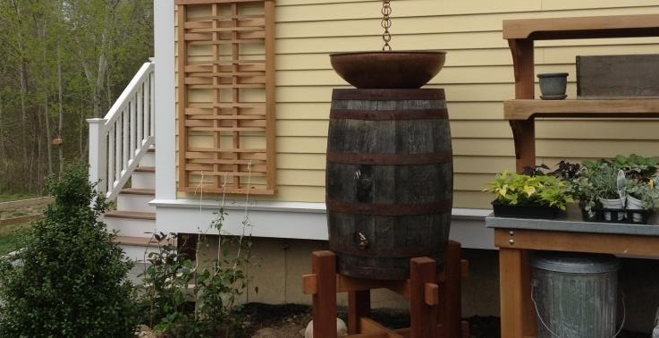
PHASE 3: Maintenance
Water Regime
THE BEST WATER REGIMES USE WATER INTELLIGENTLY AND EFFICIENTLY.
Here are six goals for a sustainable water regime:
Understand, protect, and restore any natural water system
Irrigate intelligently, deeply and sparingly
1
2
Reduce and treat stormwater runoff volume, flow rate and temperature of water
Provide increased wildlife habitat
3
4
Enhance the beauty of residential property
Collect and conserve water
5
6
A home rain barrel installation
See the following pages and EPA’s Water-Efficient Landscaping for strategies on how to make these goals a reality.

Slide 33
PHASE 3: Maintenance
Water Regime: Saving Water
To address difficulties with providing a consistent supply of clean water, Burlington has connected to the MWRA system. This will add approximately 3.5 MGD to the peak 3.5 MGD supplied by the Mill Pond Reservoir.
In an effort to decrease peak water demand, Burlington has implemented a year-round outdoor water restriction (1st Step).
1st Step Mandatory Outdoor Water Restriction:
Automated or sprinkler watering allowed every other day based on the address of the residential or commercial property (even numbered on even days, odd numbered on odd days). Residents and commercial properties can choose to water either between midnight and 9 a.m. or between 5 p.m. and midnight on their odd/even day. No double watering allowed on any given day.
These water conservation measures would apply to all residential and commercial properties. Under these restrictions no watering will be allowed between the hours of 9 a.m. and 5 p.m.
Outdoor watering restrictions consist of:
Irrigation of lawns via sprinklers or automatic irrigation systems
The following uses are permitted on any day at any time:
Watering of gardens, flowers, and ornamental plantings by means of a hand-held hose only.
To meet core functions of a business or commercial activity
Applying necessary surface treatments (aka washing exterior surfaces) such as paint, preservatives, stucco, pavement, or cement.
Car washing and filling of pools during 1st and 2nd steps only

Slide 34
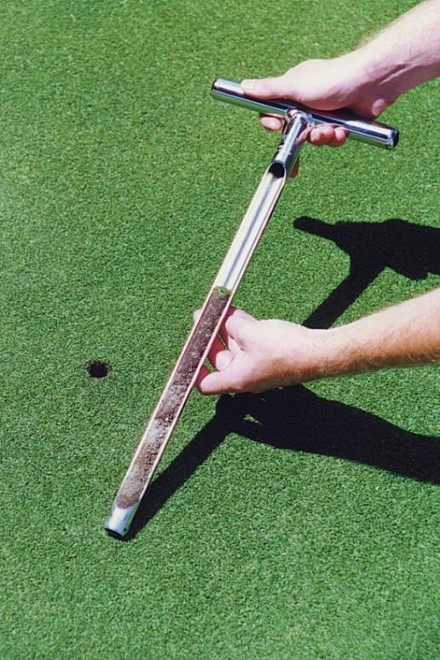
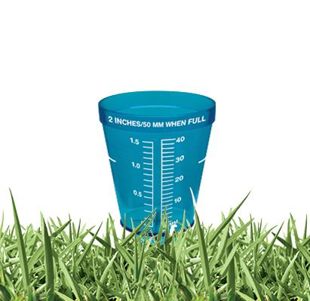
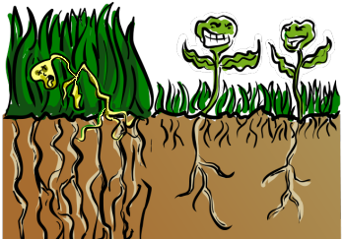
PHASE 3: Maintenance
Water Regime: Saving Water
HOW MUCH WATER DO I NEED?
The amount of water you need to care for your landscape, depends on your soil – and everyone’s soil is different. For example, clay soil will hold water longer than sandy soil. A soil probe can help you determine what kind of soil you have.
PRO-TIP
UMass Amherst provides a soil and plant nutrient testing service and can provide an analysis of your soil and recommendations on how to improve it.
While the amount of water you need can vary greatly based on your soil, the general recommendation is 1 inch of water per week. This comes out to 625 gallons per 1,000 square feet. You can monitor the amount you use by checking the meter on your irrigation system before and after using your system. If you do not have an irrigation system, there are other tools available! Rain gauges help you determine how much water your landscape is getting naturally from rain to avoid over watering. If less than one inch falls per week, consider using supplemental watering to keep new plants vigorous.

Slide 35
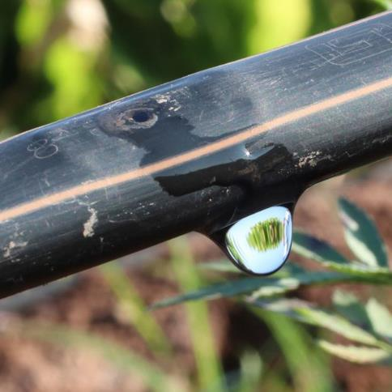
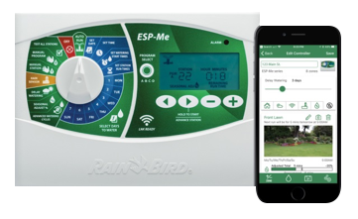
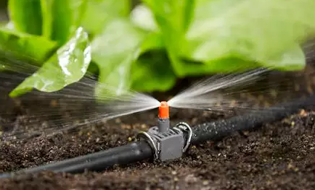
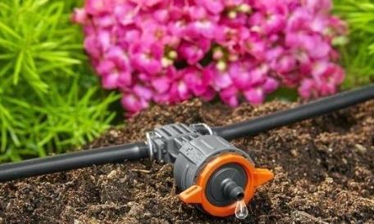
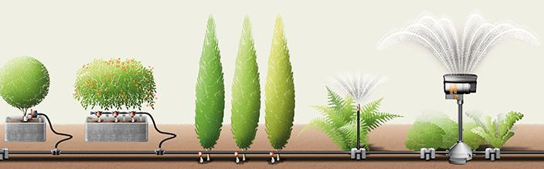
PHASE 3: Maintenance
Water Regime: Irrigation Systems
When installed correctly, drip irrigation is one of the most efficient ways to distribute water across your landscape. Interested in how drip irrigation works? Dig into the engineering behind it!
*App available with LNK WiFi Module, sold separately.
PRO-TIP
Wi-Fi irrigation systems can be a great way to monitor and control the amount of water you use. They automatically adjust based on the weather!
When watering water beds, micro-drip irrigation can be highly effective. These systems allow you to install mini emitters with various drip speeds, aimed directly at plant roots.

Slide 36
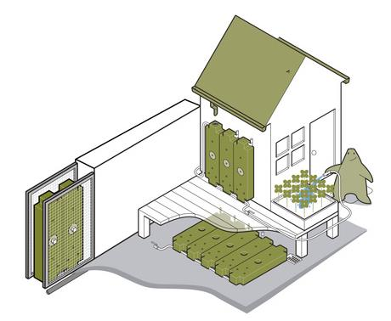
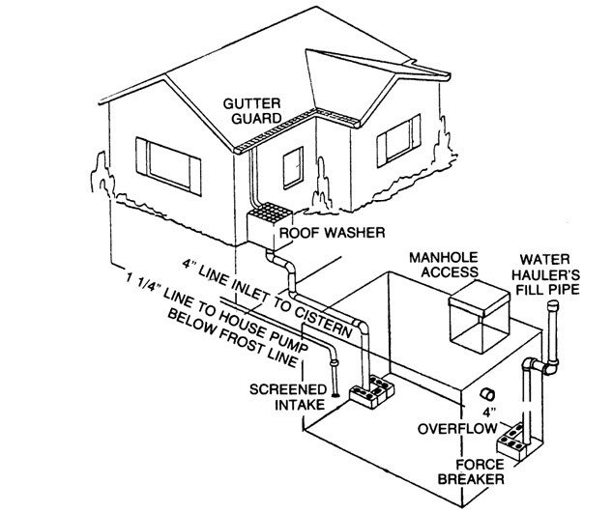
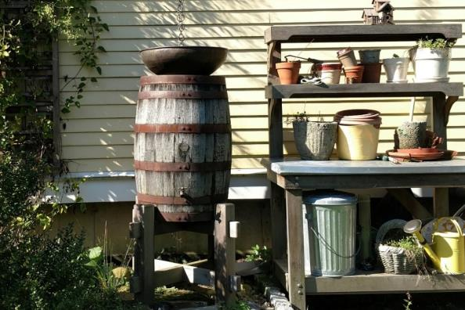
PHASE 3: Maintenance
Water Regime: Rainwater Recapture
Reusing rainwater for your outdoor water needs is a great way to decrease your water consumption (and bills!). There are a number of ways to capture water and reuse it on your property.
Rainwater HOGs water storage tanks are narrow tanks that can be stored vertically against a wall or horizontally, tucked under a porch or other structure.
Rainwater cisterns utilize a system of gutters and downspouts that direct water from the roof to a storage tank, typically located underground. One can then use pumps to supply water back to the house for uses that don’t require water that is of drinking quality.
A rain barrel is a simple system that collects and stores rainwater from your roof for reuse on your landscape. The Conservation Department offers rain barrels every other year.

Slide 37
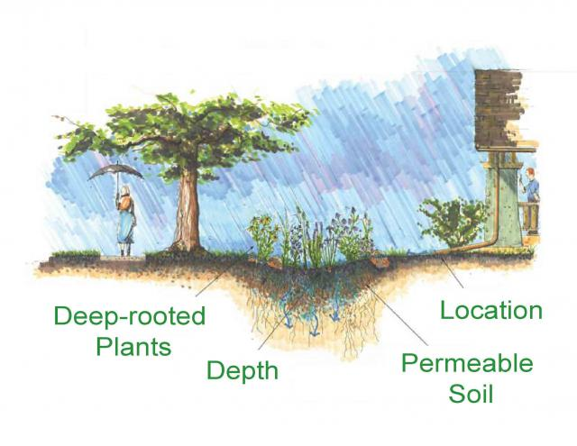
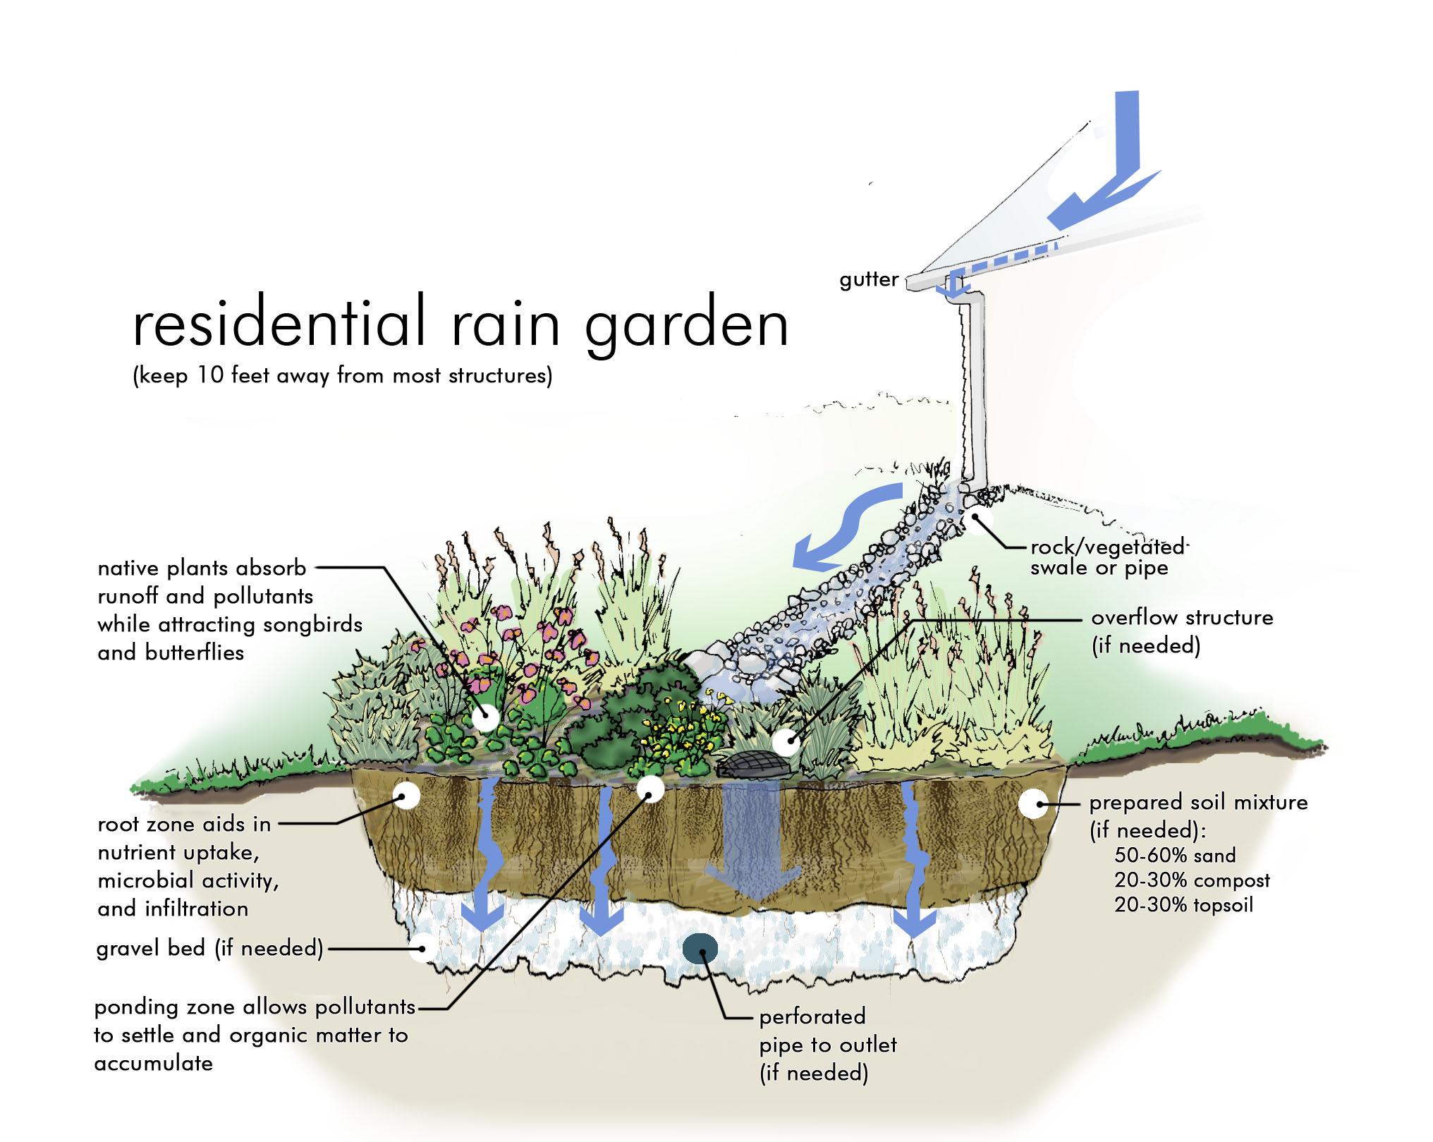
PHASE 3: Maintenance
Water Regime: Rain Gardens
Rain gardens are depressions in the landscape designed to capture and infiltrate stormwater in permeable soils. They are designed to reduce the amount of stormwater runoff that carry pollutants into streams and rivers. The most effective rain gardens are designed with deep rooted native plants well adapted to the unique conditions they present. An added benefit of rain gardens is that they can create habitats that may not otherwise exist on your property.
RAIN GARDEN BEST PRACTICES:
Direct water from a down spout or other drainage system into a low-lying area at least 10 feet from buildings and other structures
Ensure soil beneath is capable of infiltrating water
Consider adding a gravel bed beneath the soil to help water infiltrate to the groundwater
Consider adding a perforated pipe for additional drainage if you are concerned about water overflowing

Slide 38

PHASE 3: Maintenance
Water Regime: Rain Gardens (continued)
Determining the size of your rain garden is easy! Follow the steps below to get a rough idea of how big your garden should be to accommodate water draining from your house and other areas of impervious surface.
Calculate the total impervious surface area draining to rain garden by multiplying width by length. This includes the rooftop, driveway, patio, walkways and compacted lawn areas.
Multiply the area by the amount of average rainfall (lets assume 1”).
Divide by the depth of the rain garden (typically 6”).

Slide 39


PHASE 3: Maintenance
Certified Landscapes
While there is no water stretch code, there are a number of ways to formally certify your landscape as meeting certain sustainability criteria.
EPA WaterSense: has a number of certification programs for both professionals and homeowners.
LEED: While better known for its energy standards, LEED also includes criteria such as outside water reduction and inclusion of enough green open space

Slide 40




PHASE 3: Maintenance
Lawn Care
Open space for kids and pets to play is great, but over time lawns can become an issue if fertilizers and herbicides are used. Chemicals used on lawns turns into harmful runoff that pollutes our water bodies. Lawns are also contributing to decreasing biodiversity. Alternative lawn care can reduce the negative environmental impacts of lawns.
NATURALLY REPLENISH SOIL NUTRIENTS:
The loss of available nutrients is why imported chemical fertilizers are often used. Instead:
Make your own mulch out of lawn clippings and leaves. Simply, run over your leaves with your lawn mower (hopefully, hand-powered or electric!).
Rake compost across your lawn. This is typically done in the Spring to help promote healthy soils all season long.
These alternatives will naturally provide nutrients to your soil.
PRO-TIP
Leaves and lawn clippings can also be left in a compost pile and used as mulch for other plant and gardens.
Compost on top of lawn
BEST PRACTICE
PRO-TIP
Clover is not the enemy! Having naturally occurring species, like dandelions and white clover may have unexpected benefits, such as keeping rabbits away, fixing nitrogen, providing nectar and pollen for bees, and being evergreen during times of drought.
Mt. Auburn Cemetery has a no-rake policy for leaves. Instead they chip and spread leaves on the lawn. When they started, the organic content of the soil was 2-3%. Now, ten years later, it’s 8-10%.

Slide 41


PHASE 3: Maintenance
Controlling Invasive Species
Invasives tend to come in from people traveling abroad and coming home with seeds either intentionally or unintentionally. Once established, these plants will spread their seeds and will be eaten by local wildlife, spreading their seeds even further. Some invasive plants are problematic because they do not have any natural competitors and therefore spread rapidly and beat out native species, leading to decreased biodiversity. Invasive species are an ongoing concern, so they need to be addressed during Phase 2 and 3 of your landscaping project.
The Massachusetts Invasive Plant Advisory Group has published recommendations to prevent, control and, where possible, eradicate invasive plant species and provides a comprehensive list of local invasive species. The following pages outline best practices to manage some of the most common invasive species in the Burlington area.
Animals aren’t the only ones spreading invasive species. Read how humans play a role as well, and how proactive weeding can help slow the spreading.
?
DID YOU KNOW?
According to the National Wildlife Federation, 42% of native plants and animals are at risk because of invasive species.

Slide 42





PHASE 3: Maintenance
Controlling Invasive Species: Best Management Practices
While invasive species spread quickly and can seem overwhelming to control, there are a number of management best practices that do not require harmful herbicides.
MANUAL
Hand pulling is an effective method for small plants and those that are loose rooted.
Weed wrenches allow you to clamp onto the base of a plant and lever it out of the ground.
MECHANICAL
Only necessary for a very large-scale infestation, mechanical equipment can be used to remove the plants. Large amounts of exposed surfaces are vulnerable to rapid spreading of invasive species, so be sure to replant the area right away.
GRAZING
Grazers, such as goats can be used for invasive species on the fringe between a meadow and wetland. However, goats can be picky and may not eat all invasive species.
BIOLOGICAL
Biological controls, such as releasing beetles, can also be used to control invasive species. This method does not completely eradicate the species but does allow for a balance with other species.
Fifth graders at a garlic mustard “pulling party”
Weed wrench

Slide 43





PHASE 3: Maintenance
Controlling Invasive Species: Specific Tactics
Not all plants can be treated by grazing or by biological means. Discover what invasive plants might be in your yard and how you can take action.
ASIATIC BITTERSWEET
This very strong woody vine – most recognizable by its bright orange berries – strangles trees and, if left unchecked, will eventually pull them down. This plant has very distinctive orange roots, which need to be removed in their entirety to eliminate the plant. Birds eat the berries, which not only spreads the seeds, but may also have detrimental effects on the health of the birds as there is research indicating that the berries are very low in nutritional value. See Penn State’s Treatment and Timing sheet for removal tips. Get Conservation’s approval for plans to remove Bittersweet from or near wetlands.
GLOSSY BUCKTHORN
Recognized by glossy leaves and dark bark with light spots, Glossy Buckthorn can grow to by 15 to 18 feet tall. If it hasn’t been cut, it is very easy to take out. However, mowing over this plant strengthens the root mass, making it more difficult to remove. See the Ecological Landscape Alliance for removal tips.

Slide 44









PHASE 3: Maintenance
Controlling Invasive Species: Specific Tactics
BLACK SWALLOW-WORT
Black swallow wort is a European milkweed relative, recognized by its small purple flowers. It is primarily a problem because it competes with our native milkweed, which monarch butterflies are dependent on. The roots are prone to snapping at the base of the plant, so removal requires digging up the roots. See the Sudbury Assabet Concord River Watershed fact sheet for removal tips.
GARLIC MUSTARD
In many places, garlic mustard has completely taken over herbaceous understories. It is a biannual plant, going from a rounded leaf in the first year to a more pointed leaf in the second year. Luckily, it is very easy to pull out. Visit East Multnomah Soil & Water Conservation District’s site for removal tips.
INVASIVE HONEYSUCKLES
This plant has a pale shredded bark and has very fragrant flowers in the spring. Loose rooted, invasive honeysuckles are easy to remove. However, if left unchecked, the plants can form a nearly impenetrable mass. The invasive honeysuckles are shrubs, whereas the native is a vine. See the Ecological Landscape Alliance’s fact sheet for removal tips.

Slide 45













PHASE 3: Maintenance
Controlling Invasive Species: Native Alternatives
The following native species serve as great replacements for common invasive species.
THE INVASIVE BURNING BUSH CAN BE REPLACED WITH NATIVE HIGHBUSH BLUEBERRY OR CRANBERRY.
X
THERE ARE MANY PLANTS YOU CAN CHOOSE BETWEEN TO REPLACE WOODY INVASIVES.
Serviceberry (shadbush)
Chokeberry
Red twig dogwood
Winterberry
Spicebush swallowtail
Spicebush
Bayberry
Sweet pepperbush

Slide 46








PHASE 3: Maintenance
Controlling Invasive Species: Native Alternatives
Below are effective substitutions for herbaceous invasives. These are all very beneficial for pollinators.
Milkweeds
Clustered mountainmint
Bergamot (bee balm)
Anise hyssop
New England aster
Cardinal flower
Foxglove beardtongue
Native Plants Trust is another resource for planting native species.

Slide 47




PHASE 3: Maintenance
Other Maintenance Methods
Fall is a great time to work on your landscape as that is when seeds naturally fall and there is little weed competition.
HERE ARE SOME IDEAS FOR SUSTAINABLY IMPROVING YOUR LANDSCAPE IN THE FALL:
Leave native wildflower seed heads to expand the amount of wildflowers next season
Collect native seeds for future use. Other seed resources:
New England Wetland Plants
Ernst Seeds
Wild Seed Project (New England genotype seeds)
Divide and transplant plants to spread across your property to create larger plant beds for next season
Prune overgrown plants
Sheet mulch to reduce weeds
Plant additional native trees, shrubs and perennials (conservation grade is recommended)

Slide 48

PHASE 3: Maintenance
Planting for the Future
With a changing climate, planting zones are going to shift. As you plan your landscape, consider the impacts of changing weather, changing landscapes, and the increasing frequency and intensity of drought. Notice how your plants are changing and influencing other plants.
See the following page for a report on the benefits and constraints of trees common in the Greater Boston area.

Slide 49

As the impacts of climate change become more severe, it will be increasingly important to plant trees that are resilient to those impacts. The following chart shows benefits and constraints of select trees common in the Greater Boston area. This chart was pulled from Lawrence’s Green Streets Health Impact Assessment Report.

Slide 50
Additional Resources
Native Plant Resources:
Grownativemass.org
Audubon Native Plants Database
Bigelow Nursery
New England Wetland Plants
PlantNative.org
Pollinator Resources:
MA Master Gardener Association
Massaudubon.org
Natural Resource Conservation Service Pollinator-Friendly Plants
NortheastPollinator.com
Xerces Society: Pollinator Conservation Resources
Maintenance Resources:
Massachusetts Healthy Soil Action Plan
Native Plant Trust
Native Plant Trust: Go Botany
Town of Burlington: Water Conservation Tips
Town of Burlington: Sustainable Landscaping
Town of Concord: Invasive Species
Burlington Conservation Department
Sustainable Landscape Books:
“Design with Nature” Ian L.McHarg
“Planting: A New Perspective” Noel Kingsbury & Piet Oudolf
“The American Meadow Garden: Creating a Natural Alternative to the Traditional Lawn” John Greenlee & Saxon Holt
“Designing the Sustainable Site: Integrated Design Strategies for Small Scale Sites and Residential Landscapes” Heather L Venhaus & Herbert Dreiseitl
Basic Principals of Landscape Design Gail Hanson
Grow Native Massachusetts’ list of best books

