Slide 1

Burlington's Community Choice Aggregation Program
September Town Meeting

Slide 2
Town of Burlington Aggregation Rates through Constellation NewEnergy
Energy Supply Profile | Town of Burlington Aggregation (Constellation NewEnergy) | Eversource Basic Service
Massachusetts Minimum Requirements (Default) | 13.229¢ per kWh | 15.772¢ per kWh*
+5% Green Energy | 13.447¢ per kWh | N/A
+25% Green Energy | 14.322¢ per kWh | N/A
*Eversource rate changes every February/August

Slide 3
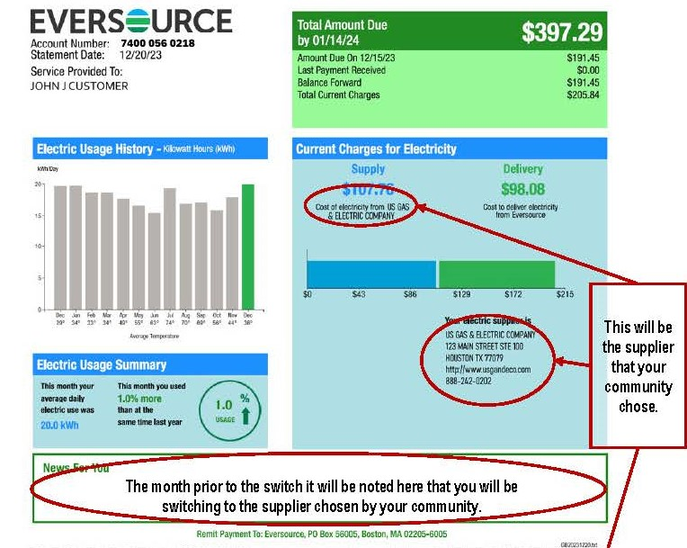
Enrollment Flow Chart:
Received Letter
Filled out Opt Out Card
Did nothing
In Program
No Letter
Existing 3rd party supply contract?
Out of Program
Call Eversource To remove yourself from Supplier Block List
Yes, Do nothing
Remain with your 3rd party supply
Yes, Opt-in*
Contact Canceled & In program
Opt-in
In Program
No. Then On Supplier Block list
Do Nothing
Out of Program
*3rd party suppliers may have exit fees/penalties check with your supplier first before opting in

Slide 4

What If I Change My Mind?
You can Opt-in or Opt-out whenever
however frequently you want
There are no fees/penalties
Simply go to colonialpowergroup.com/burlington
or call 866-485-5858 ext 1 to switch.

Slide 5

What does the town get out of this?
Nothing.
We want to offer consumers a choice, and hopefully,
lower your energy costs

Slide 6


Where can I learn More?
burlington.org/1211/municipal-aggregation
&
colonialpowergroup.com/burlington

