Slide 1
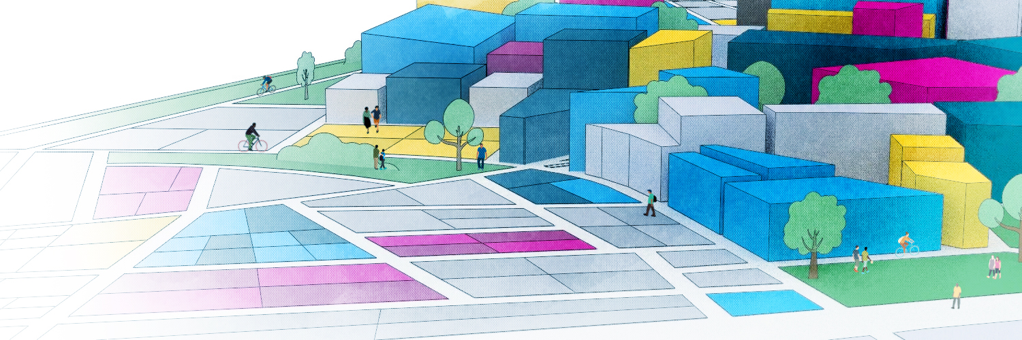
Use Table Optimization
Submitted by the Planning Board

Slide 2

Purpose
To ensure that permitting of uses aligns with the impact of the use.
To ensure that allowed uses in the underlying zoning district align with the overlay districts.
To consolidate hazardous and toxic materials uses to better align with Board of Heath processes.
To remove zoning districts that are no longer used.
What is the reason for amending the use table?
Notes:
Intent of the MIX is to allow more flexibility with regards to use, but requires conformance to heightened design standards to maintain and grow the town’s commercial sector.

Slide 3
The Motion
ZONING ARTICLE
ARTICLE NUMBER –
ARTICLE NAME – Zoning Use Table Advancement
AMOUNT – $0.00
To see if the Town will vote to remove the Retail Industrial (IR) zoning district from the entirety of the Zoning Bylaw and to amend Article IV, Sections 4.2 “Principal Use Regulation Schedule” and 4.3 “Accessory Use Regulation Schedule” (strikethrough to be removed, underlined and bold is new) as follows.

Slide 4

4.2.0 PRINCIPAL USE REGULATION SCHEDULE
REF. NO | USE DESIGNATION | DISTRICT |  |  |  |  |  |  |  |  |  |  |  | OVERLAY DISTRICTS
4.2.1 | RESIDENTIAL USES | RO | RG | RC | BN | BL | BT | MIX | BG | IG | I | IR | OS | A | WR | CC | CBD | MCMOD
4.2.1.8 | Hotel | NO | NO | NO | NO | NO | NO | YES SP | NO | SP | SP | NO | NO | YES | YES | SP₁ | SP₁ | NO
4.2.1.9 | Hotel, Residence | NO | NO | NO | NO | NO | NO | YES SP | NO | SP | SP | NO | NO | YES | YES | SP₁ | SP₁ | NO
4.2.1.10 | Motor Hotel or Motel | NO | NO | NO | NO | NO | SP | YES SP | NO | NO | NO | NO | NO | YES | YES | NO | NO | NO
4.2.2 | INSTITUTIONAL & RECREATIONAL USES | RO | RG | RC | BN | BL | BT | MIX | BG | IG | I | IR | OS | A | WR | CC | CBD | MCMOD
4.2.2.23 | Performance Theater or Center | NO | NO | NO | NO | NO | SP | YES SP | SP | SP | SP | SP | NO | YES | YES | SP₁ | SP₁ | NO
Currently, hotels are a by-right use which only requires site plan review and allows for little discretion so long as bylaw requirements are met.
Performance Theaters have high traffic demand during peak times.
Converting from YES to Special Permit in the MIX District

Slide 5
4.2.6 | RETAIL, CONSUMER, AND TRADE USES | RO | RG | RC | BN | BL | BT | MIX | BG | IG | I | IR | OS | A | WR | CC | CBD | MCMOD
4.2.6.1 | Personal Services | NO | NO | NO | SP | YES | YES | YES | YES | NO | NO | YES | NO | SP YES | SP YES | YES₁ | YES₁ | YES
4.2.6.5 | Supermarket | NO | NO | NO | NO | NO | NO | YES SP | SP | NO | NO | SP | NO | YES | YES | SP₁ | SP₁ | NO
4.2.6.11 | Restaurants | NO | NO | NO | NO | NO | NO | YES SP | SP | SP (see Art. 10.4.0) | NO | SP | NO | YES | YES | SP₁ | SP₁ | SP
MIX District is entirely within the Aquifer (A) and Water Resources (WR) overlay district and Personal Services should be an allowed use.
Supermarkets are a high-intensity use. Between the existing mall area, additional vehicular trips, deliveries, and shopping carts, this use requires a higher level of review.
Restaurants require additional permit conditions to mitigate for additional impacts.
Food Odor
Customer and Employee Parking via specifying the number of seats
Valet Parking

Slide 6

4.2.7 | INDUSTRIAL USES | RO | RG | RC | BN | BL | BT | MIX | BG | IG | I | IR | OS | A | WR | CC | CBD | MCMOD
4.2.7.14 | Hazardous and Toxic Materials and Chemicals Use, Generation, Storage, Transport, Disposal or Discharge | NO | NO | NO | NO | NO | NO | SP | NO | SP | SP | SP | NO | SP | SP | YES | YES | SP
4.2.7.17 | Generation or Storage of Hazardous Waste (Limited to the volumes classified as a very small quantity generator (VSQG)) | NO | NO | - | NO | NO | NO | SP | NO | SP | SP | SP | NO | SP | SP | YES | YES | NO
4.2.7.18 | Generation or Storage of Hazardous Waste (In excess of the volumes classified as a very small quantity generator (VSQG)) | NO | NO | - | NO | NO | NO | SP | NO | SP | SP | SP | NO | NO | SP | YES | YES | NO
Board of Health review of hazardous and toxic materials does review in terms of the amount of hazardous materials created by a company.
The Environmental Engineer reviews the total amount of hazardous and toxic materials on premises.

Slide 7
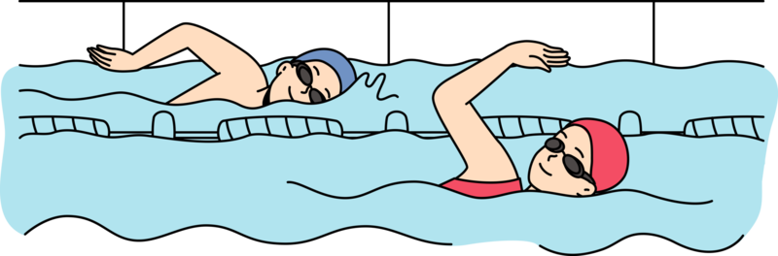
4.3.0 ACCESSORY USE REGULATION SCHEDULE
REF. NO | USE DESIGNATION | DISTRICT |  |  |  |  |  |  |  |  |  |  |  | OVERLAY DISTRICTS
4.3.1 | USES NORMALLY ACCESSORY TO RESIDENTIAL PRINCIPAL USES | RO | RG | RC | BN | BL | BT | MIX | BG | IG | I | IR | OS | A | WR | CC | CBD | MCMOD
4.3.1.9 | Swimming Pool | YES | SP | SP | SP | SP | SP | YES SP | SP | SP | SP | SP | SP | YES | YES | YES | YES | SP₁
Public swimming pools require an additional level of scrutiny by the Board of Health.
Special Permits allow for simpler enforcement by the town.

Slide 8
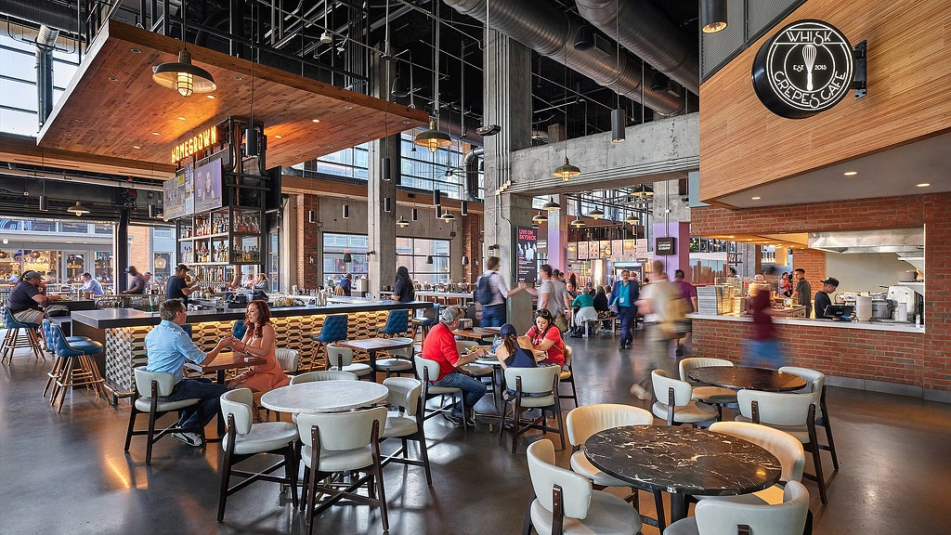
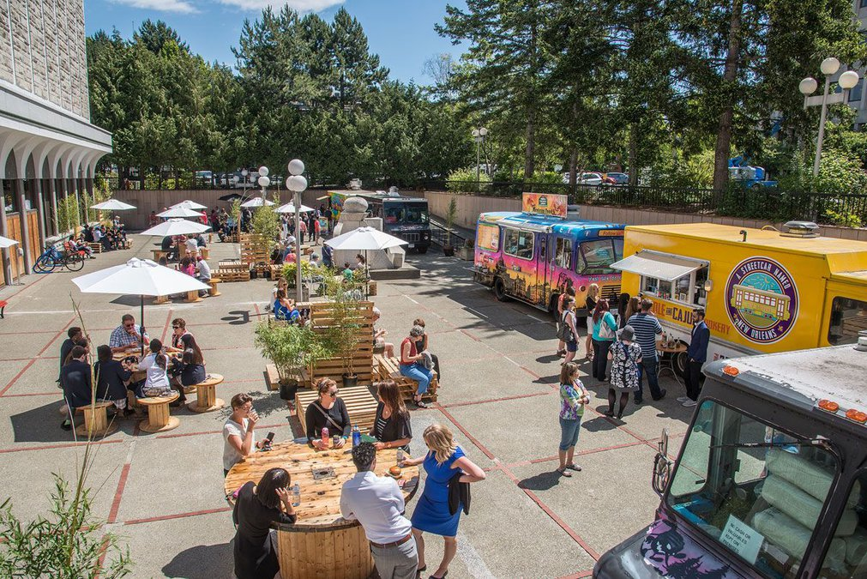
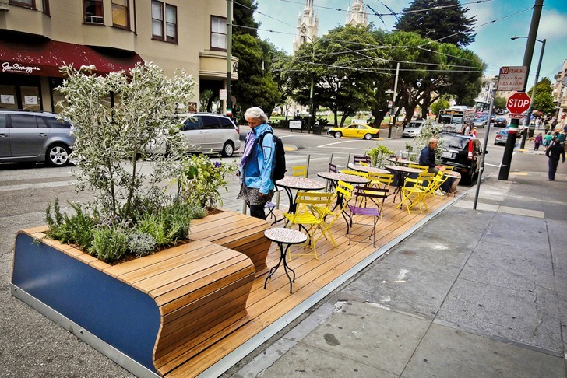
4.3.2 | USES NORMALLY ACCESSORY TO NON- RESIDENTIAL PRINCIPAL USES | RO | RG | RC | BN | BL | BT | MIX | BG | IG | I | IR | OS | A | WR | CC | CBD | MCMOD
4.3.2.31 | Food Hall or Public Market | NO | NO | NO | SP | SP | SP | YES SP | SP | SP | SP | SP | SP | NO SP | SP | SP | SP | SP
4.3.2.32 | Mobile Food Market, Vendor's Court | NO | NO | NO | SP | SP | SP | YES | SP | SP | SP | SP | SP | NO YES | SP YES | SP | SP | SP
4.3.2.34 | Parklet | NO | NO | NO | NO | NO | NO | YES | SP | NO | NO | NO | NO | NO YES | NO YES | NO | SP | NO
4.3.2.35 | Outdoor Merchandise Display | NO | NO | NO | SP | SP | SP | YES | SP | SP | SP | SP | NO | NO YES | NO YES | NO | SP | SP
Food Halls would have a master special permit, like the mall food court
Ensuring these new uses are not prohibited due to an overlay district.

Slide 9
Questions?

