Slide 1

Burlington Government Review Committee
July 8, 2025

Slide 2
Background
2018 Government Review Committee Formed
Recommendation:
Additional review warranted with following potential areas of opportunity:
Elected v. Appointed positions
Town Manager v. Town Administrator
Personnel and management reporting structure
Improved internal and external communication
50 years since the last in-depth analysis
Involve an independent agency to conduct a comprehensive analysis

Slide 3
Select Board: Charge To Committee
“The mission of the Burlington Government Review Committee (BGRC) is to ensure an appropriate, effective, and accountable organizational structure of Burlington Town government for its residents and constituents, and to recommend to the Burlington Select Board and Town Meeting suggested format and possible changes.”

Slide 4
Select Board: Requested Deliverables
Follow an open, inclusive, and thorough process that reviews all facets of government, considers all opinions, respects all points of view, researches comparable communities for alternatives, and obtains as much information as possible
Produce a Charter for the Town that provides all residents with a local government that is transparent, effective, efficient, and responsive both for present day and future generations
Consider shifting from a Town Administrator to a Town Manager form of leadership
Consider new provisions such as referendums, recalls, and periodic reviews of government structure
Delineate what structures should be in Charter versus in bylaws
Write a report to accompany the proposed Charter that clearly explains the proposed changes, outlines the specific changes that would arise as a result of it, and other policy recommendations from the Committee

Slide 5
What We Be Doing
Study the efficacy and effectiveness of the town’s form of government and governance and processes
Engage stakeholders (employees, volunteers and residents) in understanding what is working/not
Benchmark models of government in comparable communities
Identify strengths and weaknesses in Burlington’s current structure and processes, and recommend changes
Facilitate public engagement throughout the process.
Develop a Charter and Bylaw changes that reflect recommendations

Slide 6
What Is A Charter?
“Charter” refers to a written instrument that defines the government structure under which a city and town operates, that may create local offices; distribute powers, duties and responsibilities among local offices; and that may establish and define certain procedures to be followed by a city or town government. (MGL Ch. 4, Sec 7, Clause 5).

Slide 7
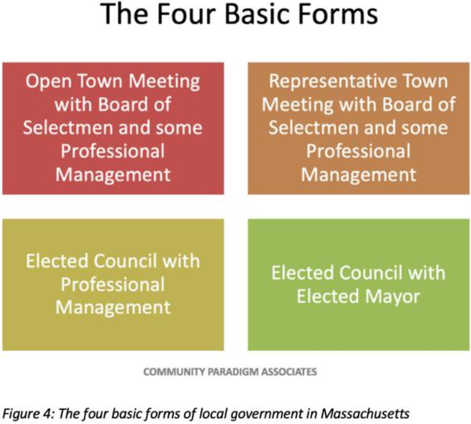
Four Basic Forms of Government in Massachusetts
Note: Changing forms of government isn’t currently the focus but will review how our form of government operates in the future

Slide 8
Methods To Change Form of Government
Charter Commission
Special Act

Slide 9
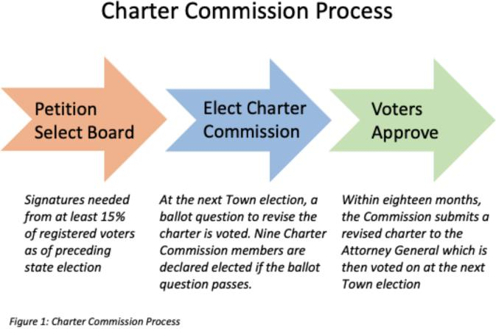
1. Charter Commission Method of Change
Requires a minimum of 15% of Burlington’s registered voters to petition the Select Board to place a question on the ballot to establish a Charter Commission. On the same ballot candidates for the Commission will be listed, and if the majority of voters vote to establish a Charter Commission, nine members of the Commission will be elected. This Commission must follow a process and timetable set forth under state law, and a new Charter is then subject to voter approval..
The process for a Charter Commission is set out under Massachusetts General Law Chapter 43B.

Slide 10
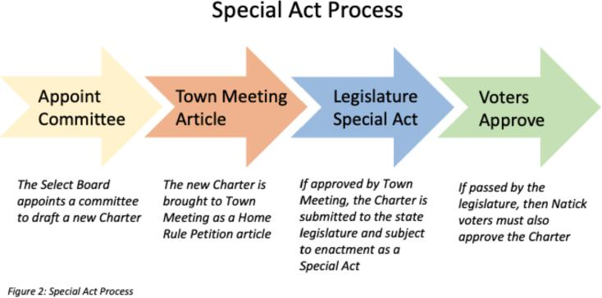
2. Special Act Option
Select Board may charge a committee with drafting a new Charter, which may then be brought to Town Meeting as a Home Rule Petition. If approved by Town Meeting, the Charter is then submitted to the Massachusetts State Legislature and subject to enactment as a Special Act, after which it must be approved by the voters at a Town election.

Slide 11
Formidable Task…..
Where and how do we start???
“Manageable Chunks”

Slide 12
Step 1: With Collins Center Guidance Identify Key Project Components
EXAMPLE:
Understand Current Structure
Assess Current State (What’s Working/Not)
Stakeholder Interviews, Focus Groups, Surveys (identify the areas and functions that
could be improved before looking into different forms of municipal government that could diminish or eliminate some or all of these problems)
Staff
Volunteers (TM, Boards and Committees)
Community
Analyze Best Practices (Comparative Analysis)
Comparative Analysis of Towns deemed to be most relevant to Burlington
Pros and Cons
Communications Strategy and Execution
Community
Sponsors
Develop Recommendations

Slide 13
Step 2: Identify Specific Tasks
EXAMPLE:
Current State Analysis
Tactics
Interviews of employees
Identify Survey Tool
Survey of Town Meeting Members
Survey of Town Residents
Identify Opportunities for Improvement
Benchmark Analysis
Identify MA communities to benchmark
Xxxxx
xxxxx

Slide 14
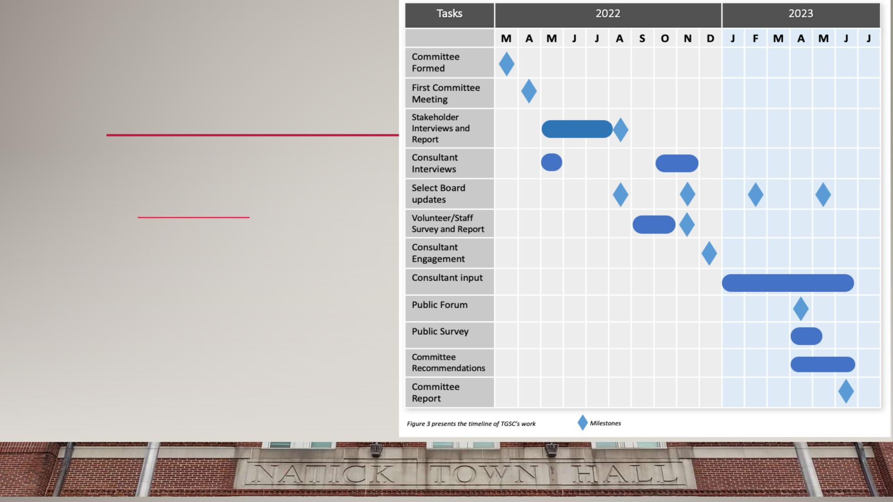
Step 3: Develop Project Plan
EXAMPLE:
Tasks
Timeframes
Deliverables

Slide 15
Step 4: Establish Subcommittees
Identify Key components of Project e.g. tasks/research that need to be done/timeframes.
Establish/assign small subcommittees as workgroups who dig in to the task and will present findings to committee
Larger committee discusses, makes decisions on what recommendations will be made.

Slide 16
Step 5: Put It All Together
In Partnership with the Collins Center
Identify areas of opportunity
Create a report
Outline process
Recommended changes
Next steps
Present to Select Board and Town Meeting

Slide 17
BGRC: How We’ll Operate
Start with public comments about things not on the agenda… limited to 3 minutes.
We want to encourage collaboration and active discussions with actionable outcomes
Roberts Rules will be used as inspiration but not specifically followed
Some discussions may be put in the “parking lot” to be revisited at end of meeting
Suggested process for Committee
The leader of the discussion topic will determine:
If questions will be taken during or after the presentation
How discussion and questions will be taken (i.e. open discussion or members should raise their hands and the Chair will call on them for comment).
At the end of each agenda item “Action Steps” will be determined with dates for completion.
If there is a need for a vote
Each member of the committee will be called on for final comment and vote.

Slide 18
What We Ask of You
Get sworn in and sign Open Meeting document
Participate in meetings
Be open to new ideas
Stay on topic
Allow for equitable input/discussion
If you have nothing new to add, that’s fine
Volunteer for Committees
Come prepared
Give feedback to Jess and Betsey after meetings… what worked well/didn’t

Slide 19
So What’s Next?
Collins Center
Brainstorm
Preliminary Project Plan Preview

Slide 20
Appendix

Slide 21
What Is A Charter?
“Charter” refers to a written instrument that defines the government structure under which a city and town operates, that may create local offices; distribute powers, duties and responsibilities among local offices; and that may establish and define certain procedures to be followed by a city or town government. (MGL Ch. 4, Sec 7, Clause 5).

